Slide 1
Architecture is a product of the culture that it was designed for.
Notes:
So in this program we are not really teaching Architecture or design instead it becomes a tool for Culturally Centered Education, still focusing on the Science behind materials, Technology in visualizing virtually, Engineering comes into play in understanding construction fundamentals and methods, and the Mathematical aspect of geometry and understanding layouts.
More than all this, the combination of Science and Design makes architecture a good mode of disseminating STEM education in this project

Slide 2
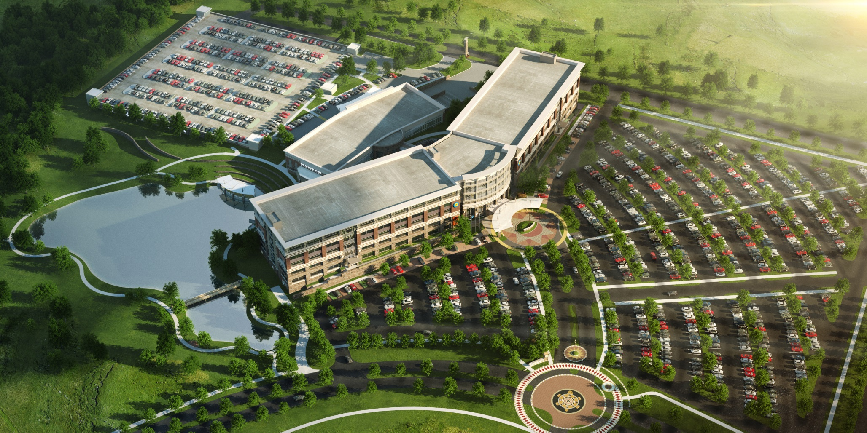
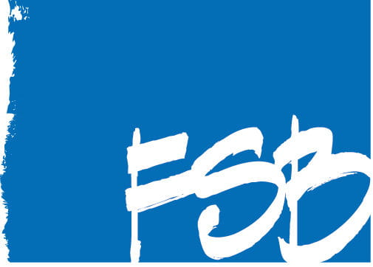
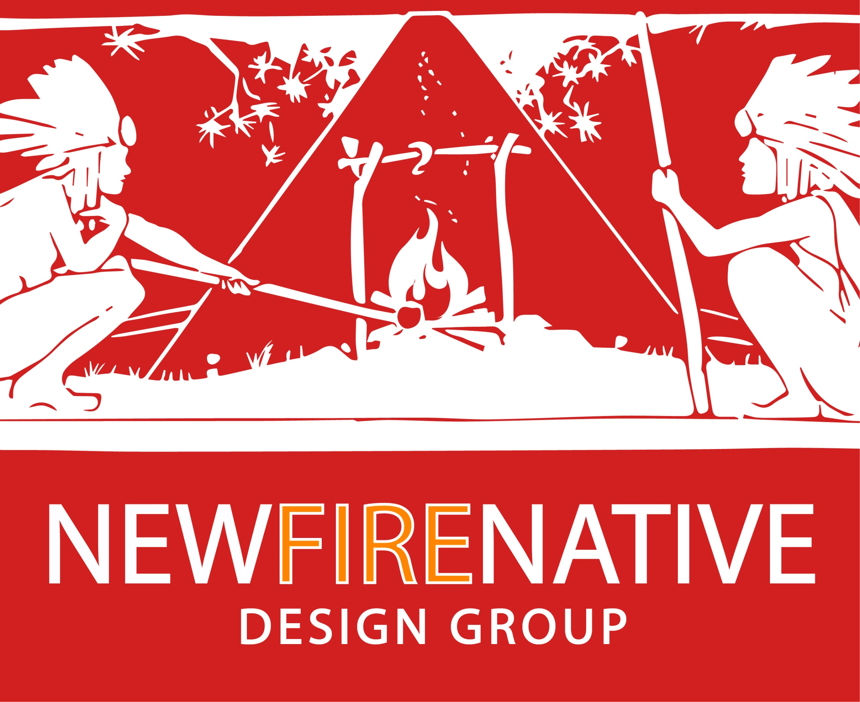
CHOCTAW NATION HEADQUARTERS MASTER PLAN
Durant, Oklahoma
Notes:
Express Choctaw heritage and culture
Create Choctaw design vocabulary
Bring the outside in
Easy access to services
Welcoming to the Choctaw and visitors
More efficient operations
Sustainable design
frankfurt short bruza -OKC

Slide 3
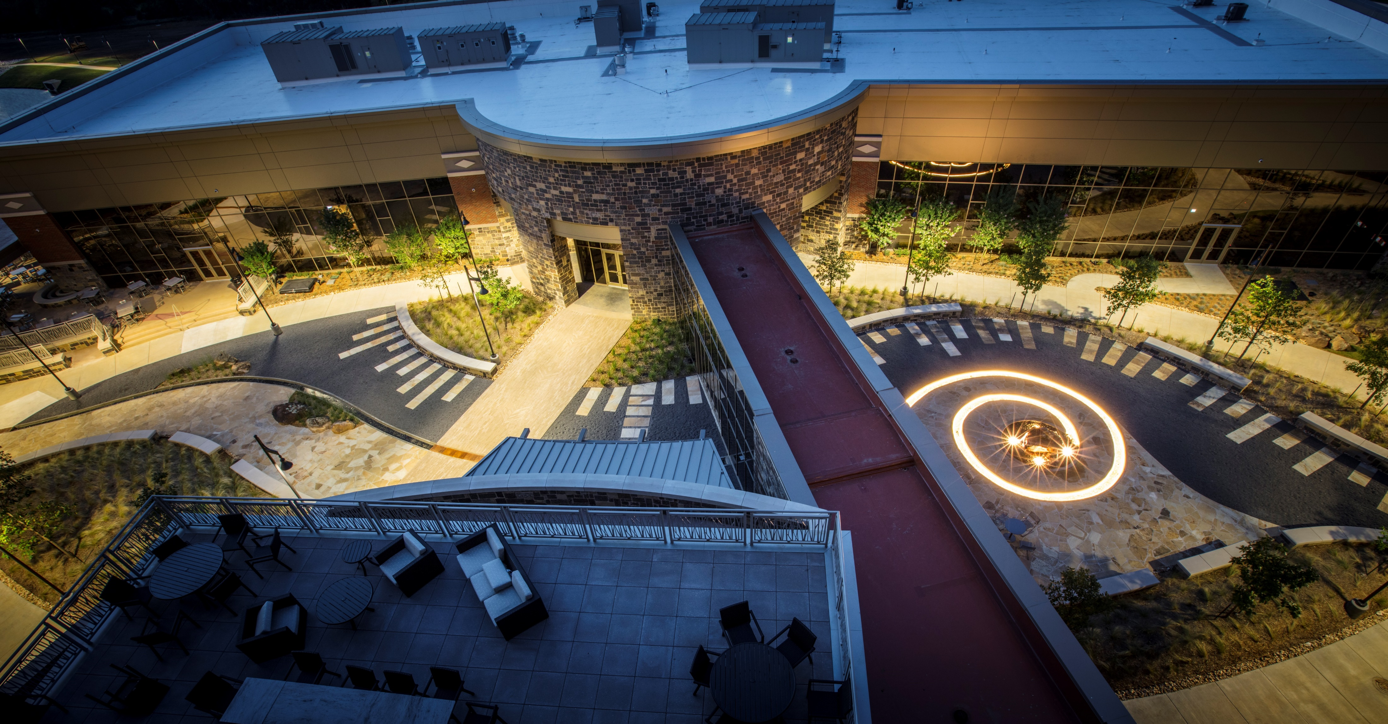

Slide 4
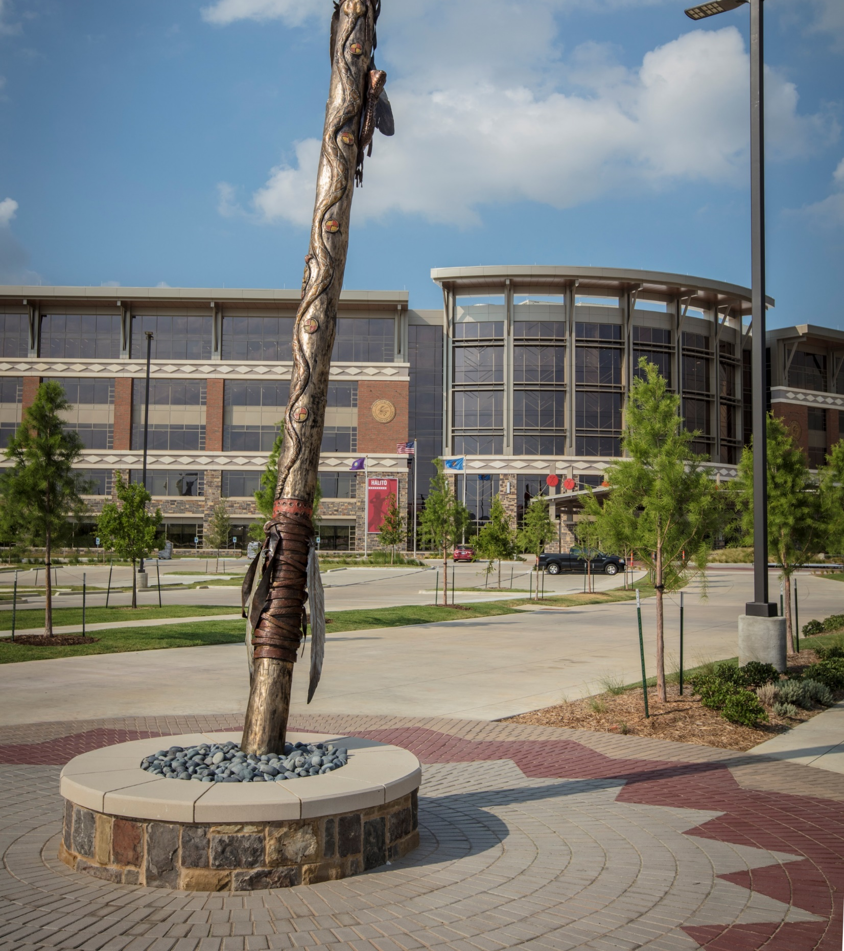
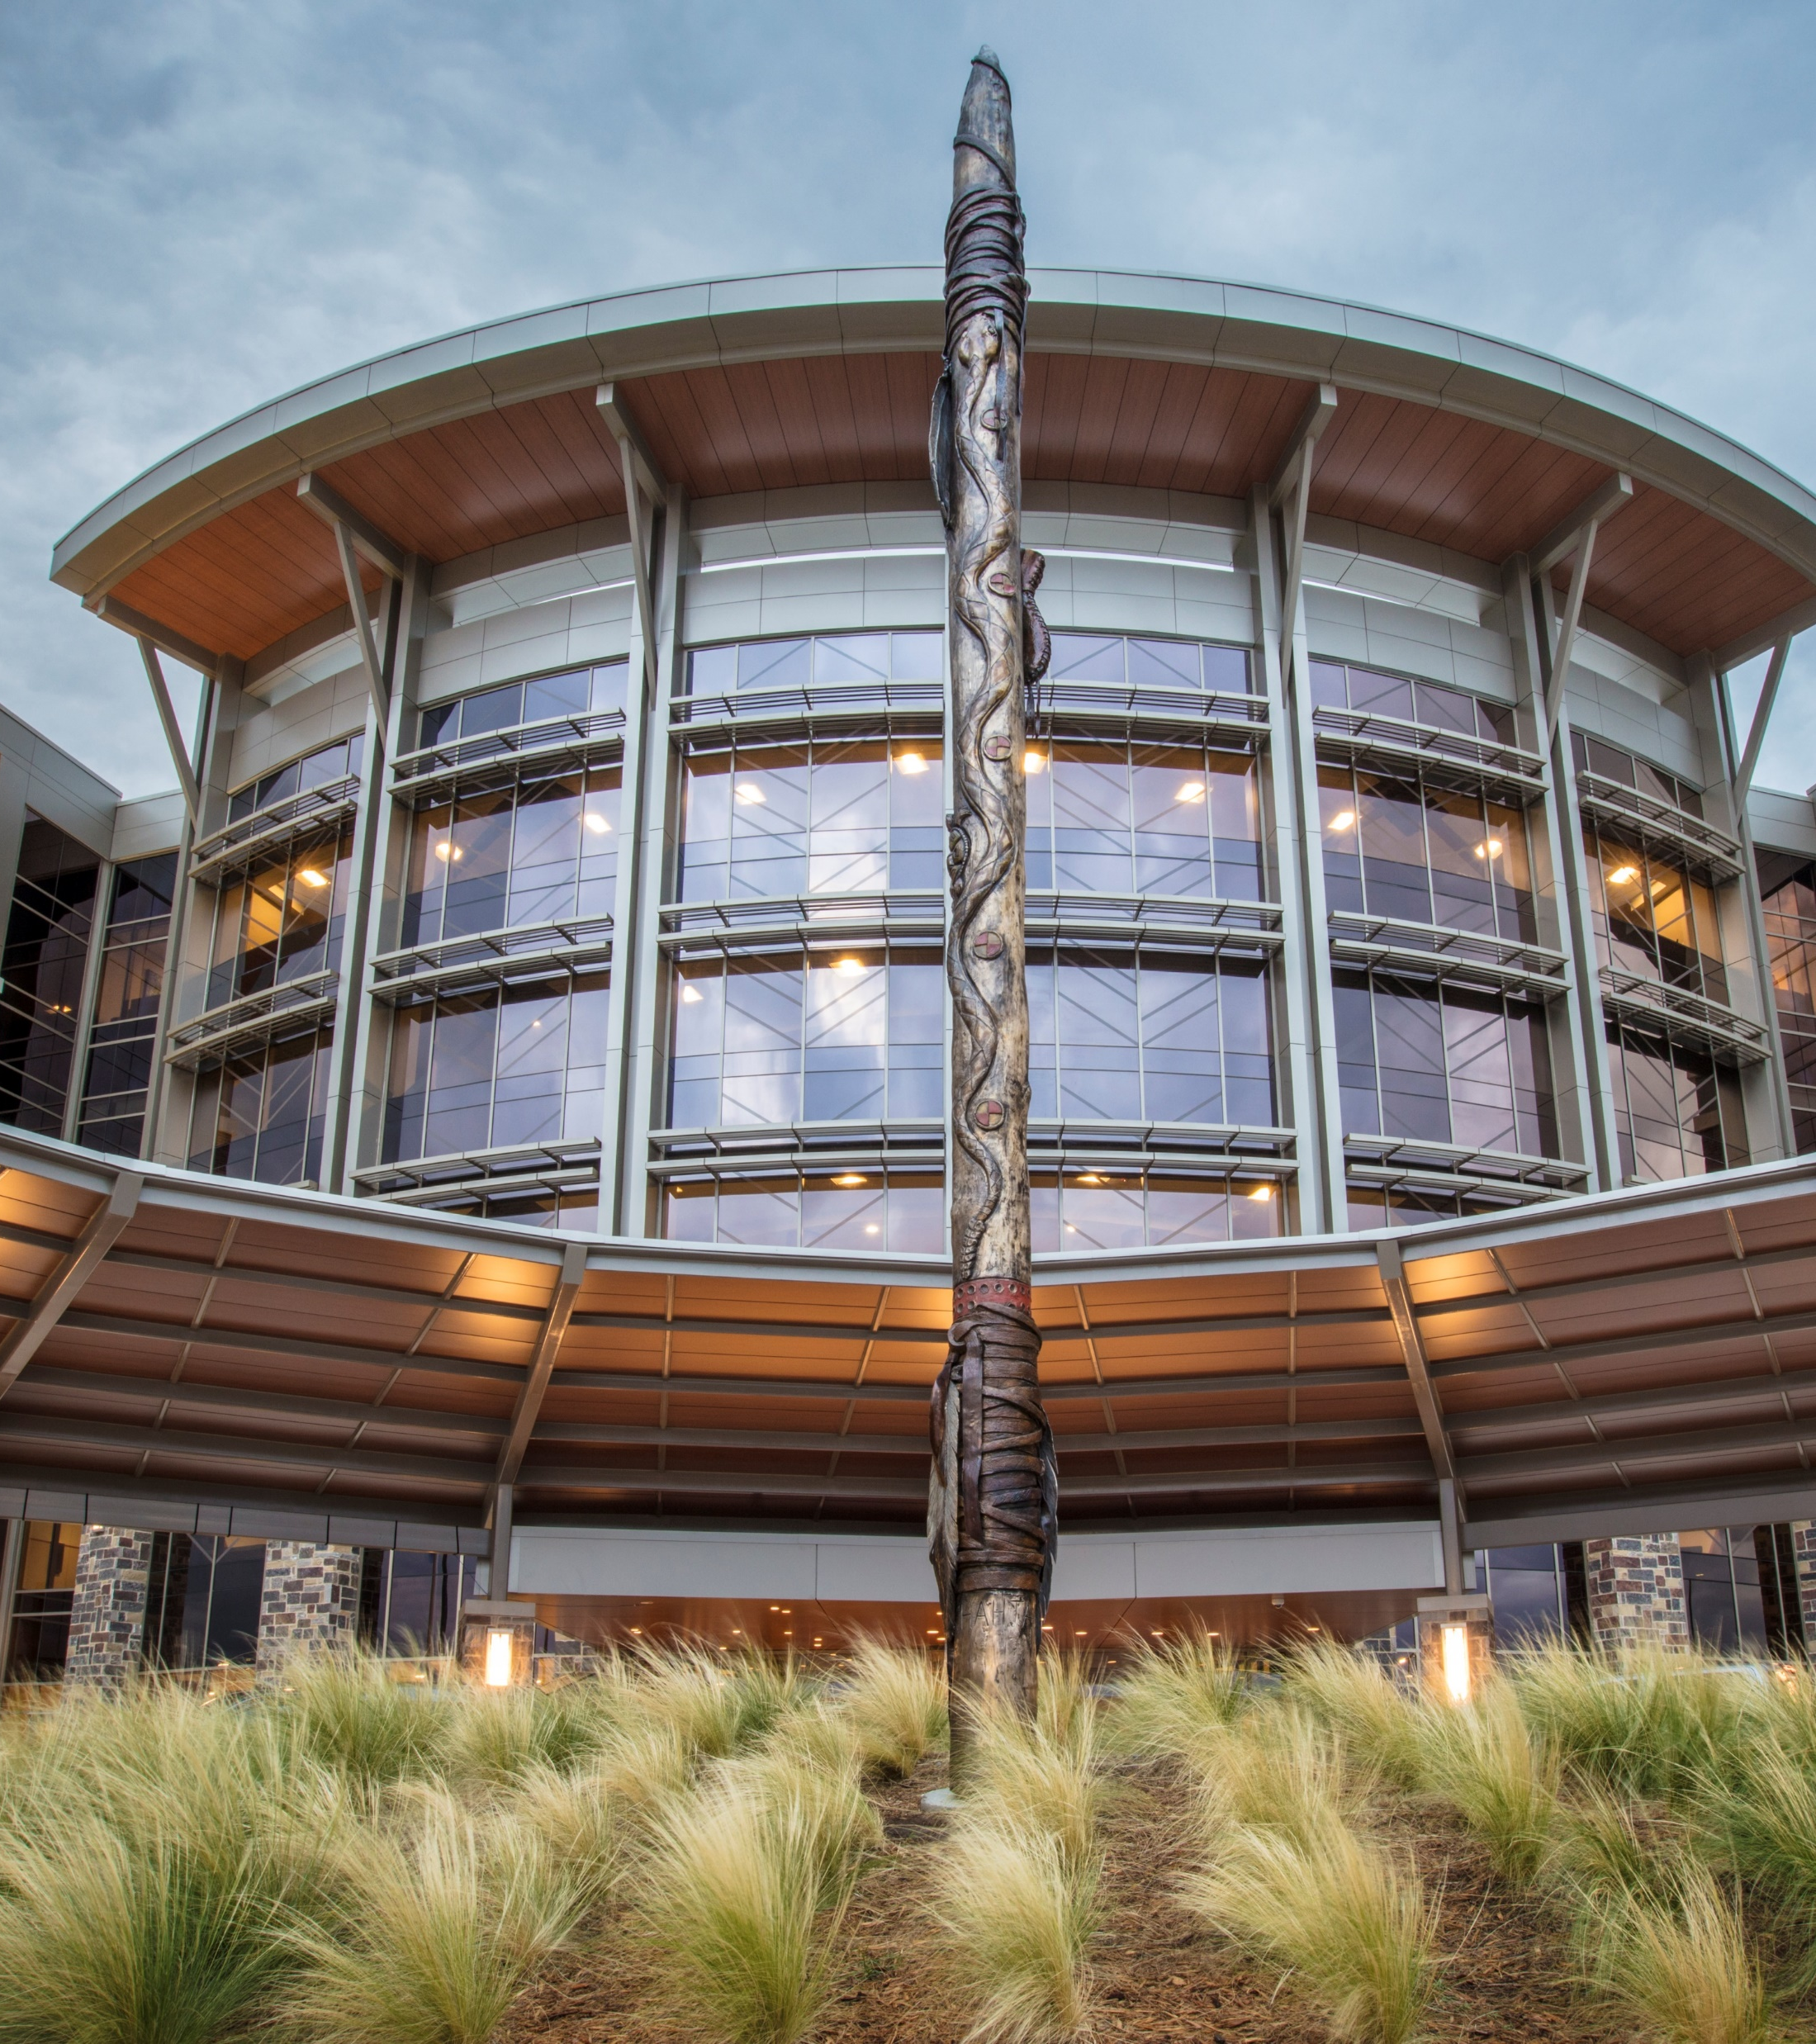
Notes:
It is said that Two brothers, Chata and Chicksah, led the original choctow people from a land in the far west that had ceased to prosper. The people traveled for a long time, guided by a magical pole . Each night, when the people stopped to camp, the pole was placed in the ground, and in the morning the people would travel in the direction in which the pole leaned.
After travelling for a very long time, they finally came to a place where the pole stood upright. In this place, they laid to rest the bones of their ancestors, which they had carried in buffalo sacks from the original land in the west.
The Leaning Pole leading to the headquarters represents this pole that led the Choctaw people to their homeland. The second one Infront of the building is straight - symbolizing that they have found home.

Slide 5
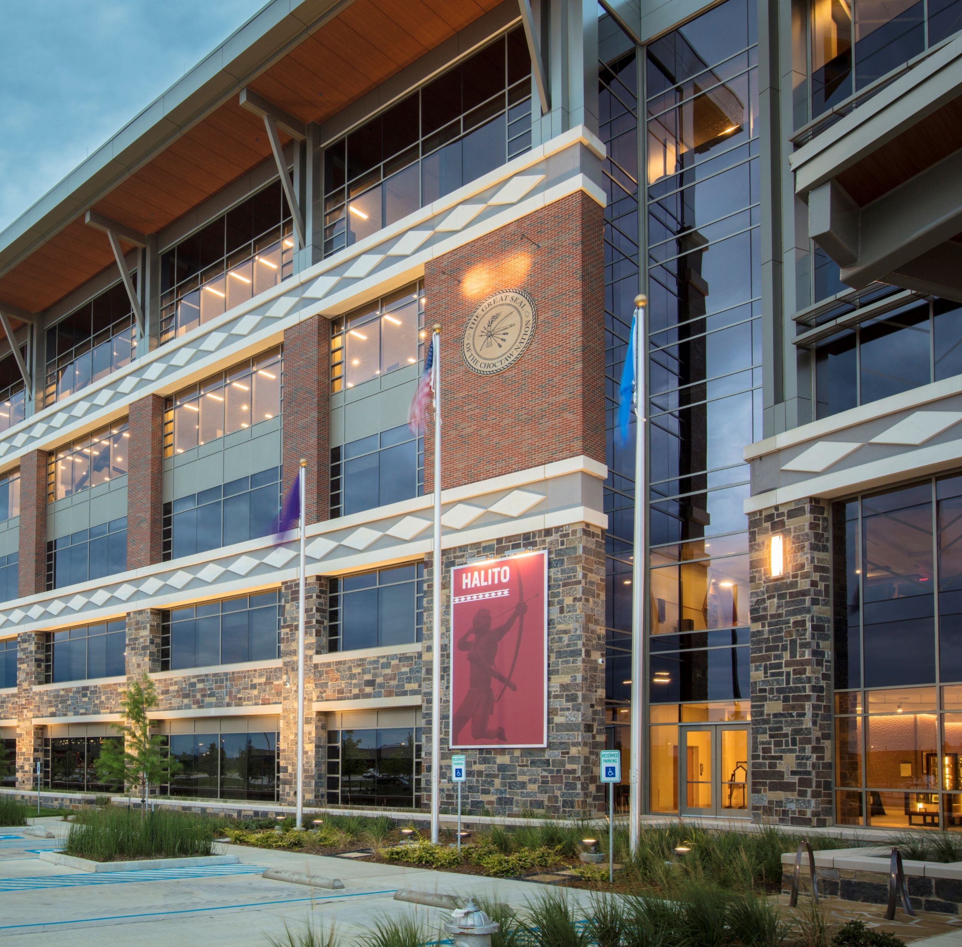
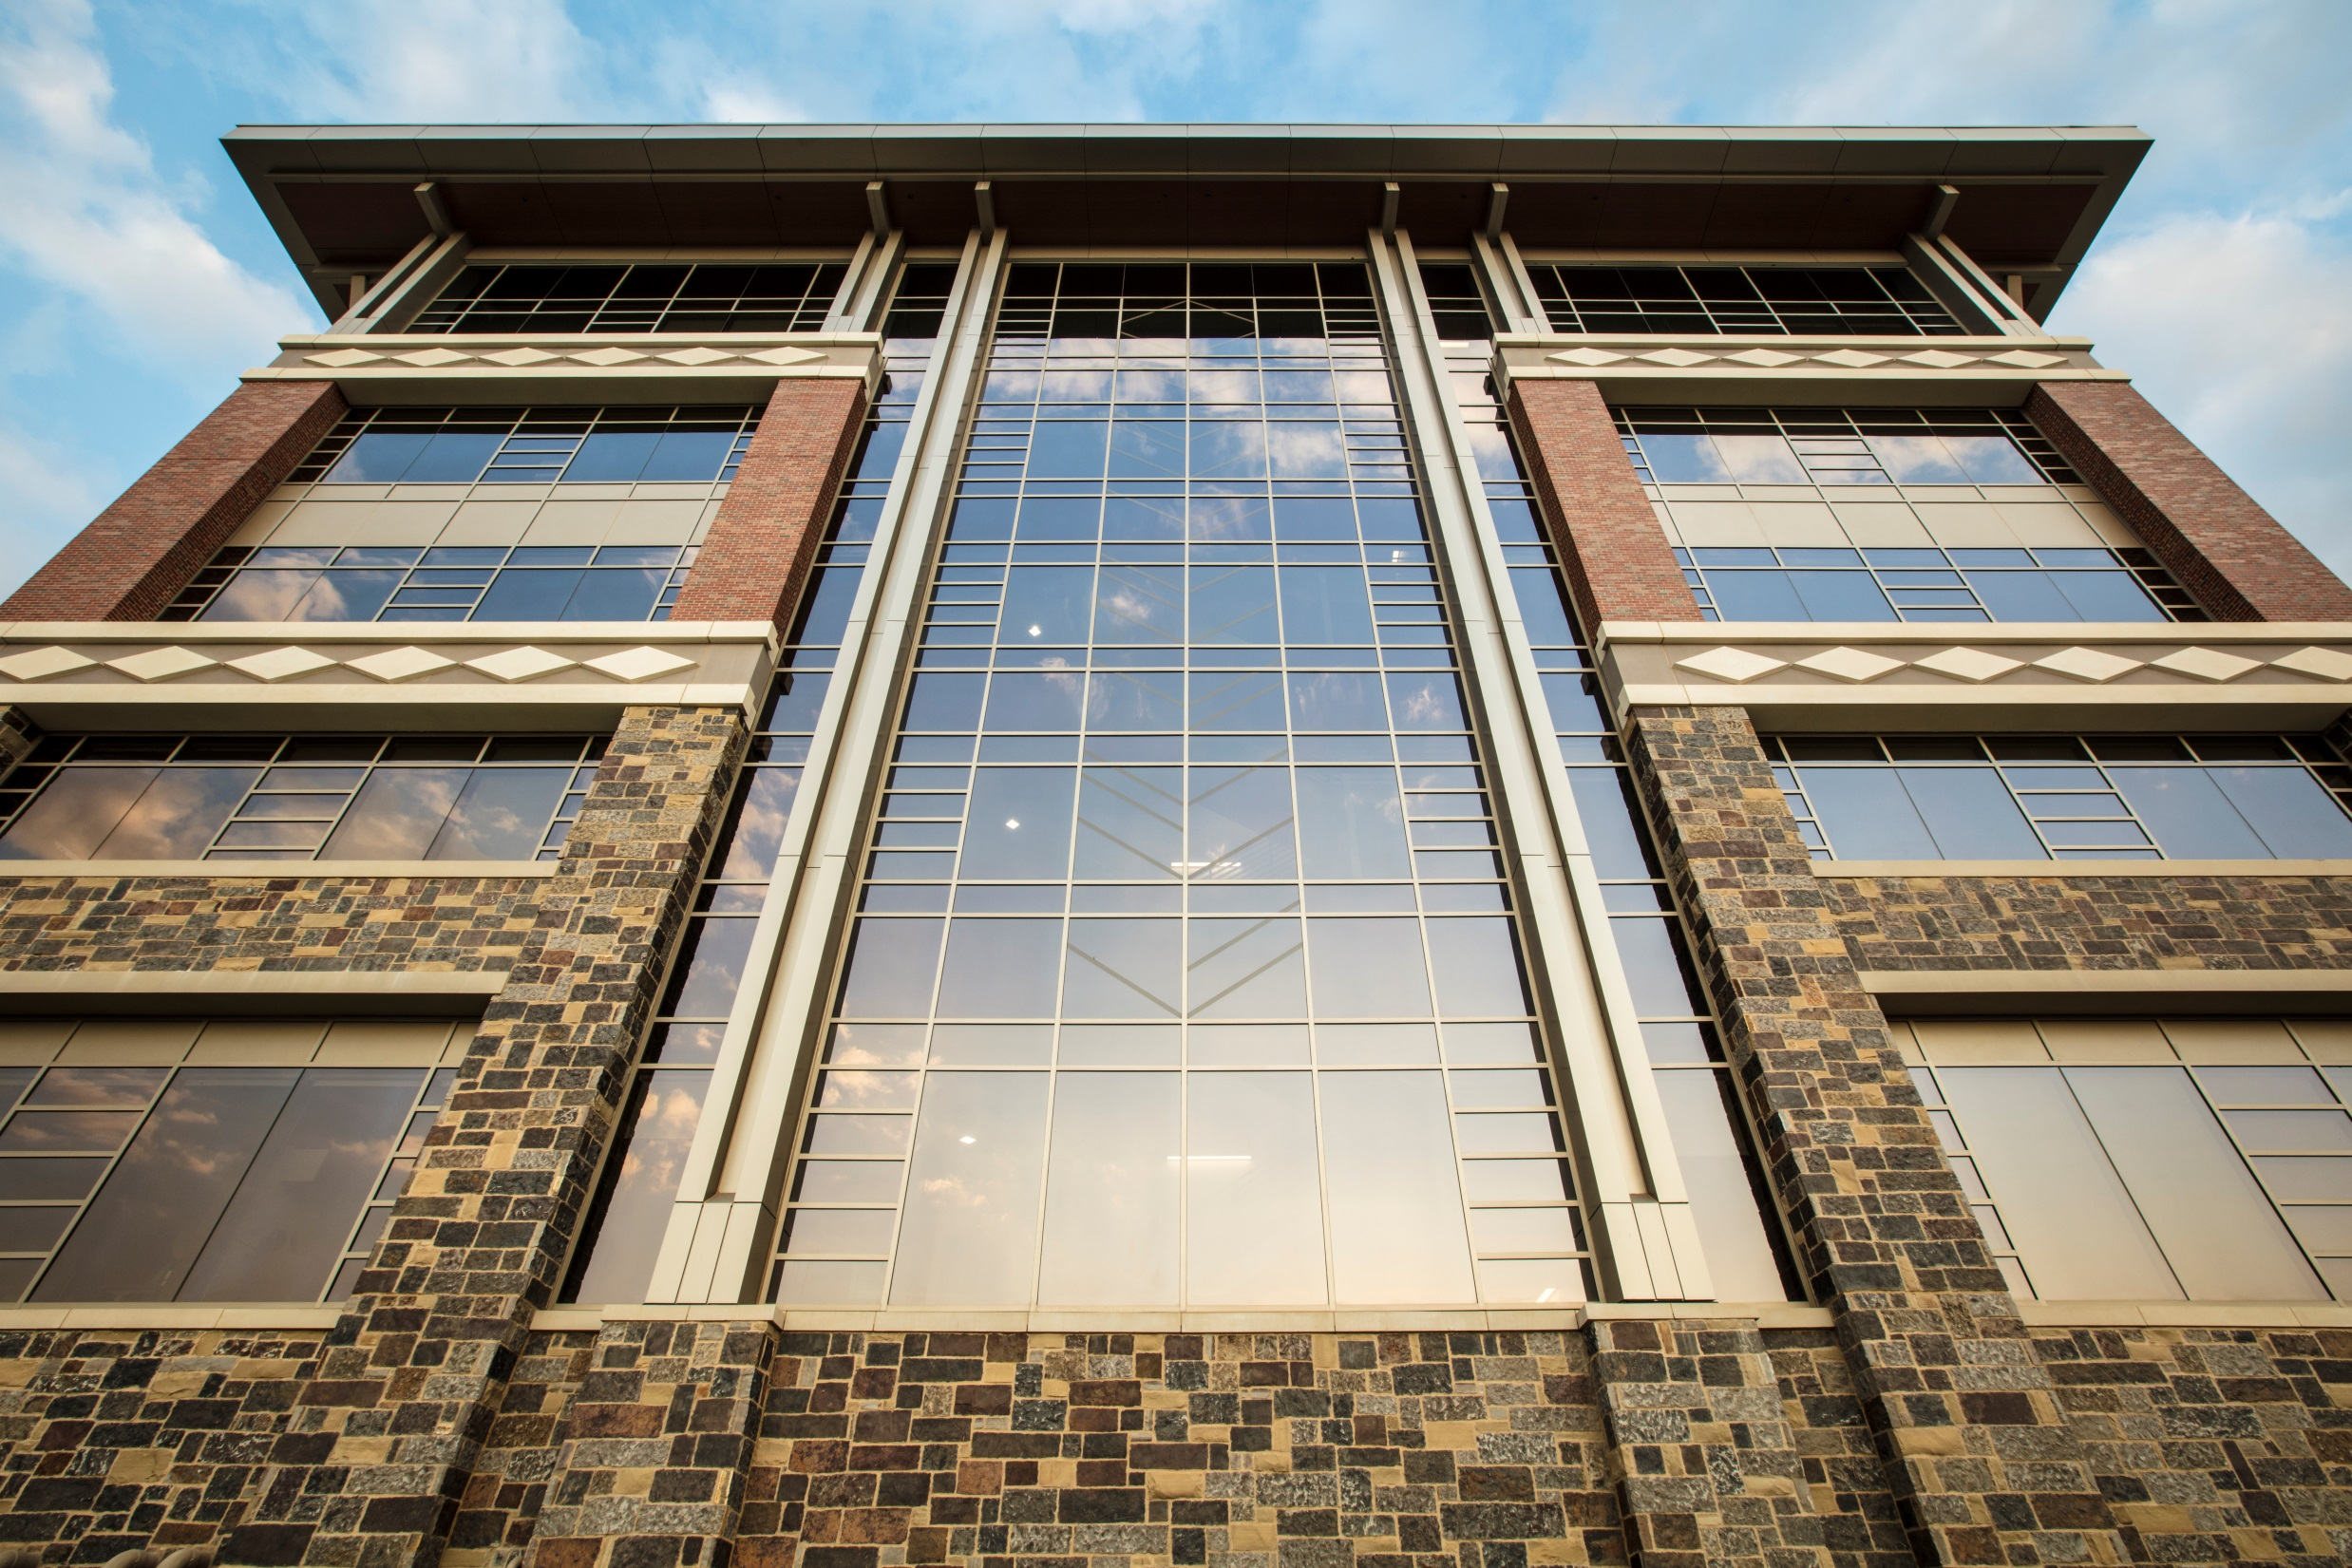
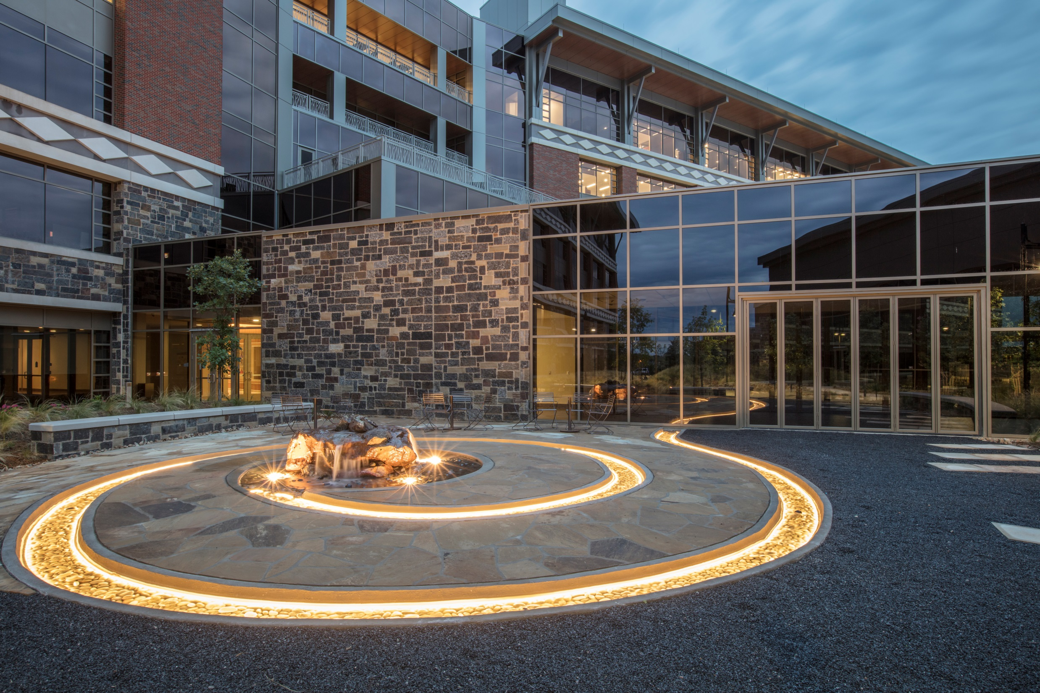
Notes:
The diamond often represents the Eastern Diamondback Rattlesnake, but when in a border, such as on the outside of the headquarters and in Choctaw clothing, it represents a pathway. You see diamond stepping stones placed within the landscaping.
When visiting the headquarters diamonds can be found in many places inside such as the water wall behind the front desk and the walls of the gift shop.
Diamonds can also be found in the windows of the headquarters.

Slide 6
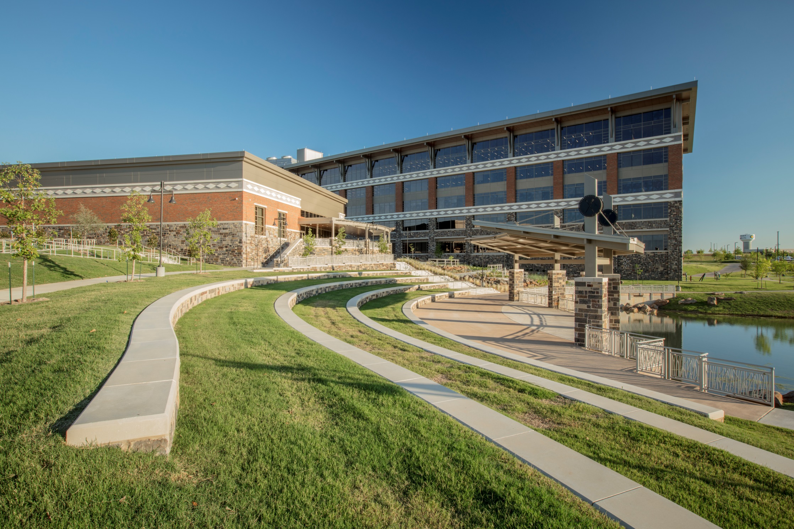
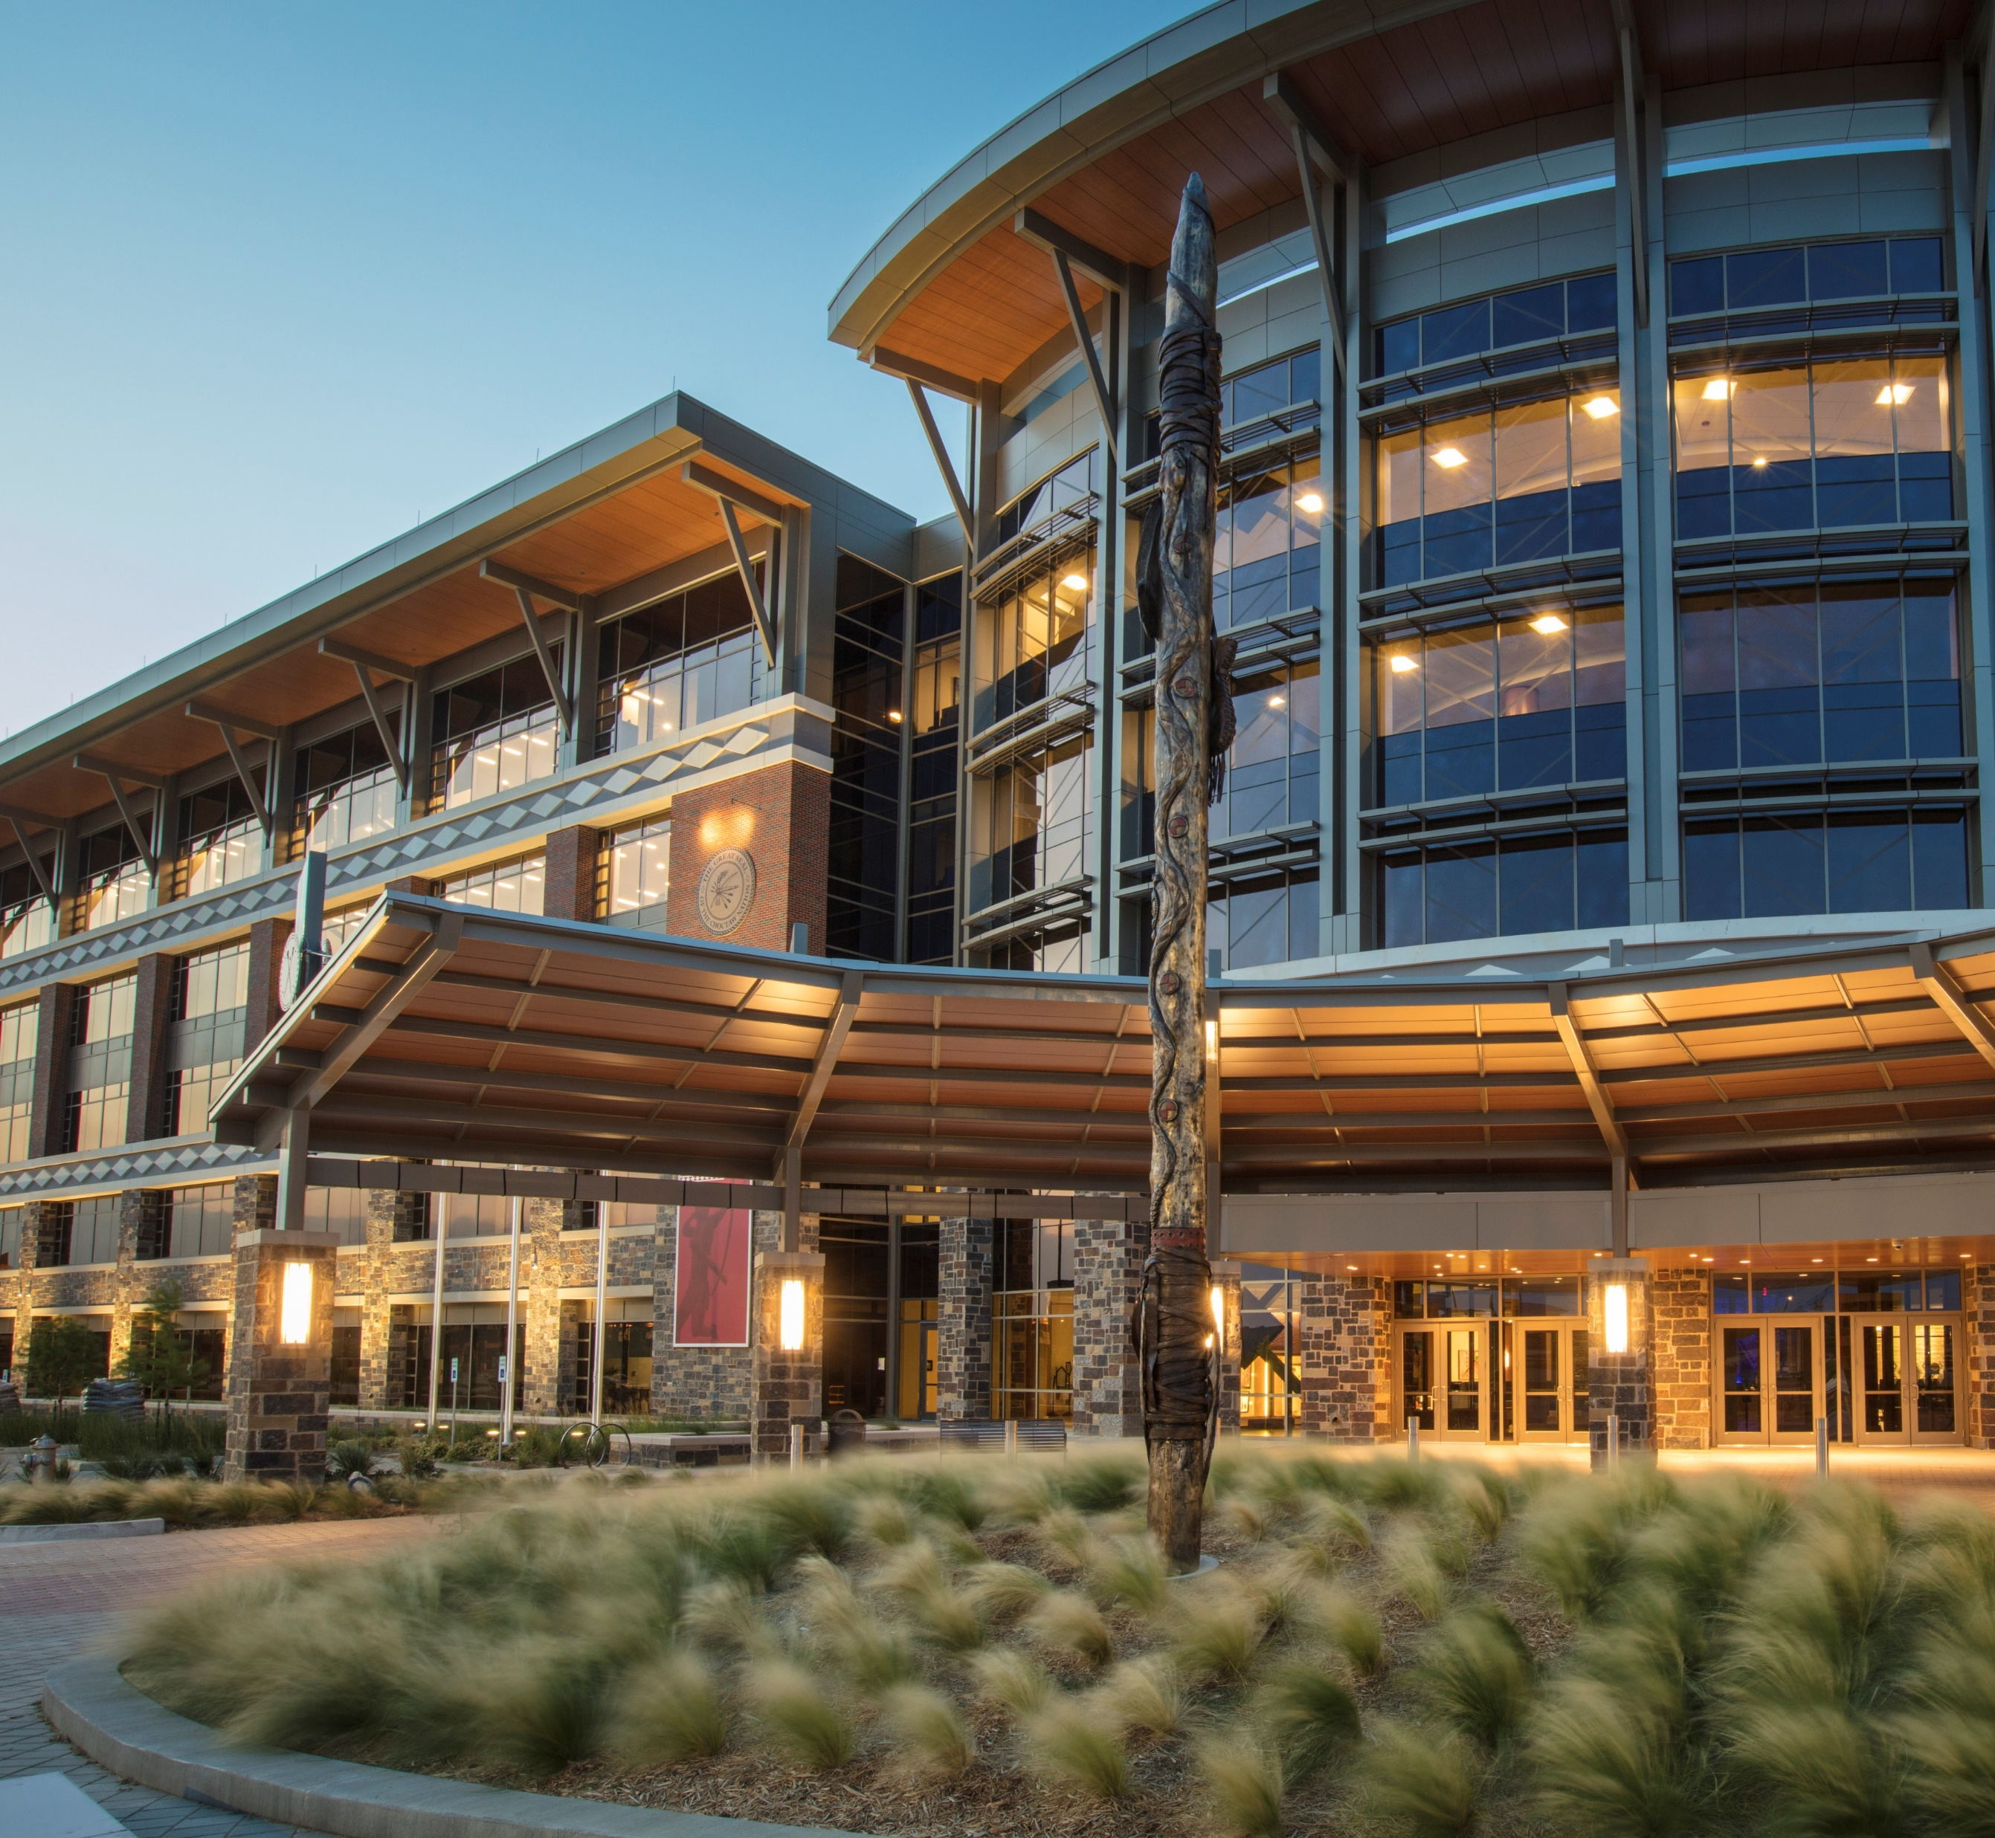
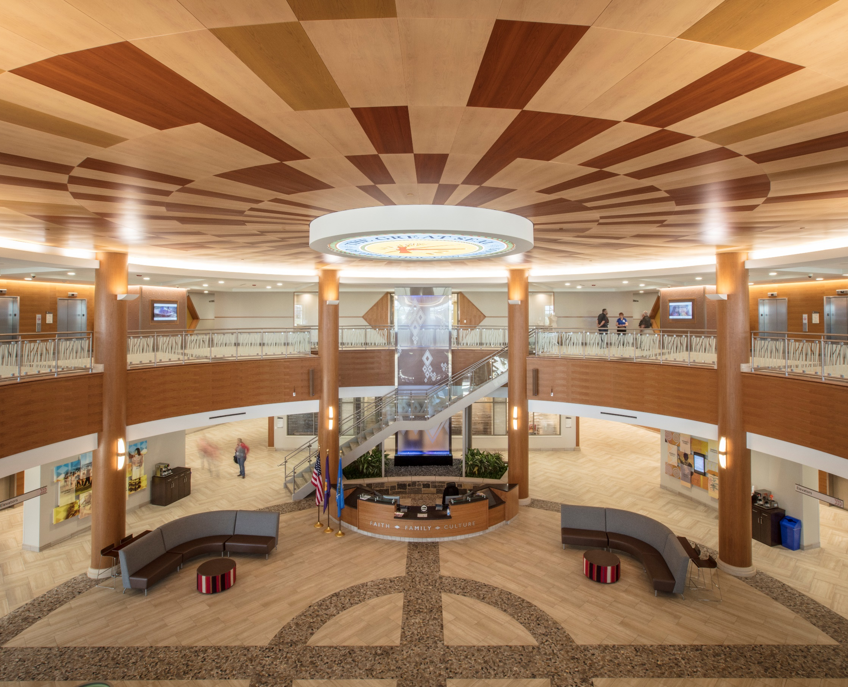
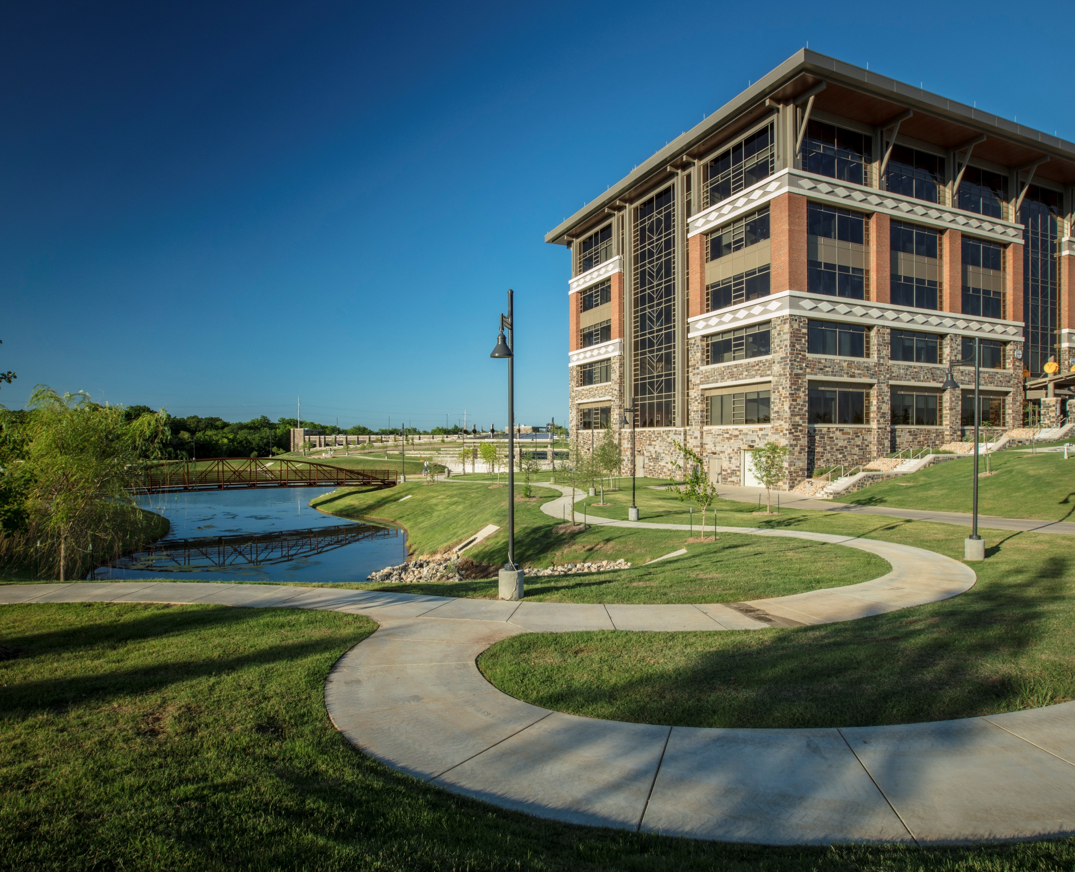
Choctaw Nation
Headquarters Master Plan
Durant, Oklahoma
Notes:
natural stone on the outside of the building represents the connection with nature while the red brick is a reminder of the former headquarters. Each floor of the headquarters represents a different element of nature: earth, wind, fire/sun and water.

Slide 7
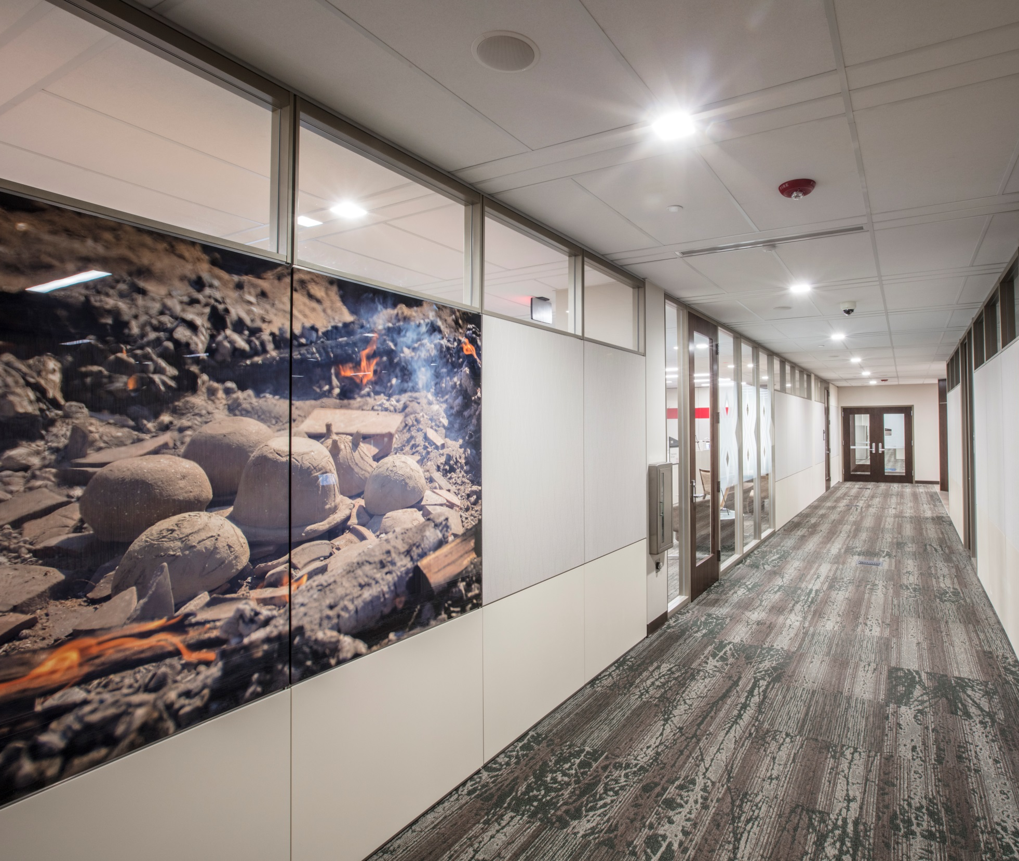
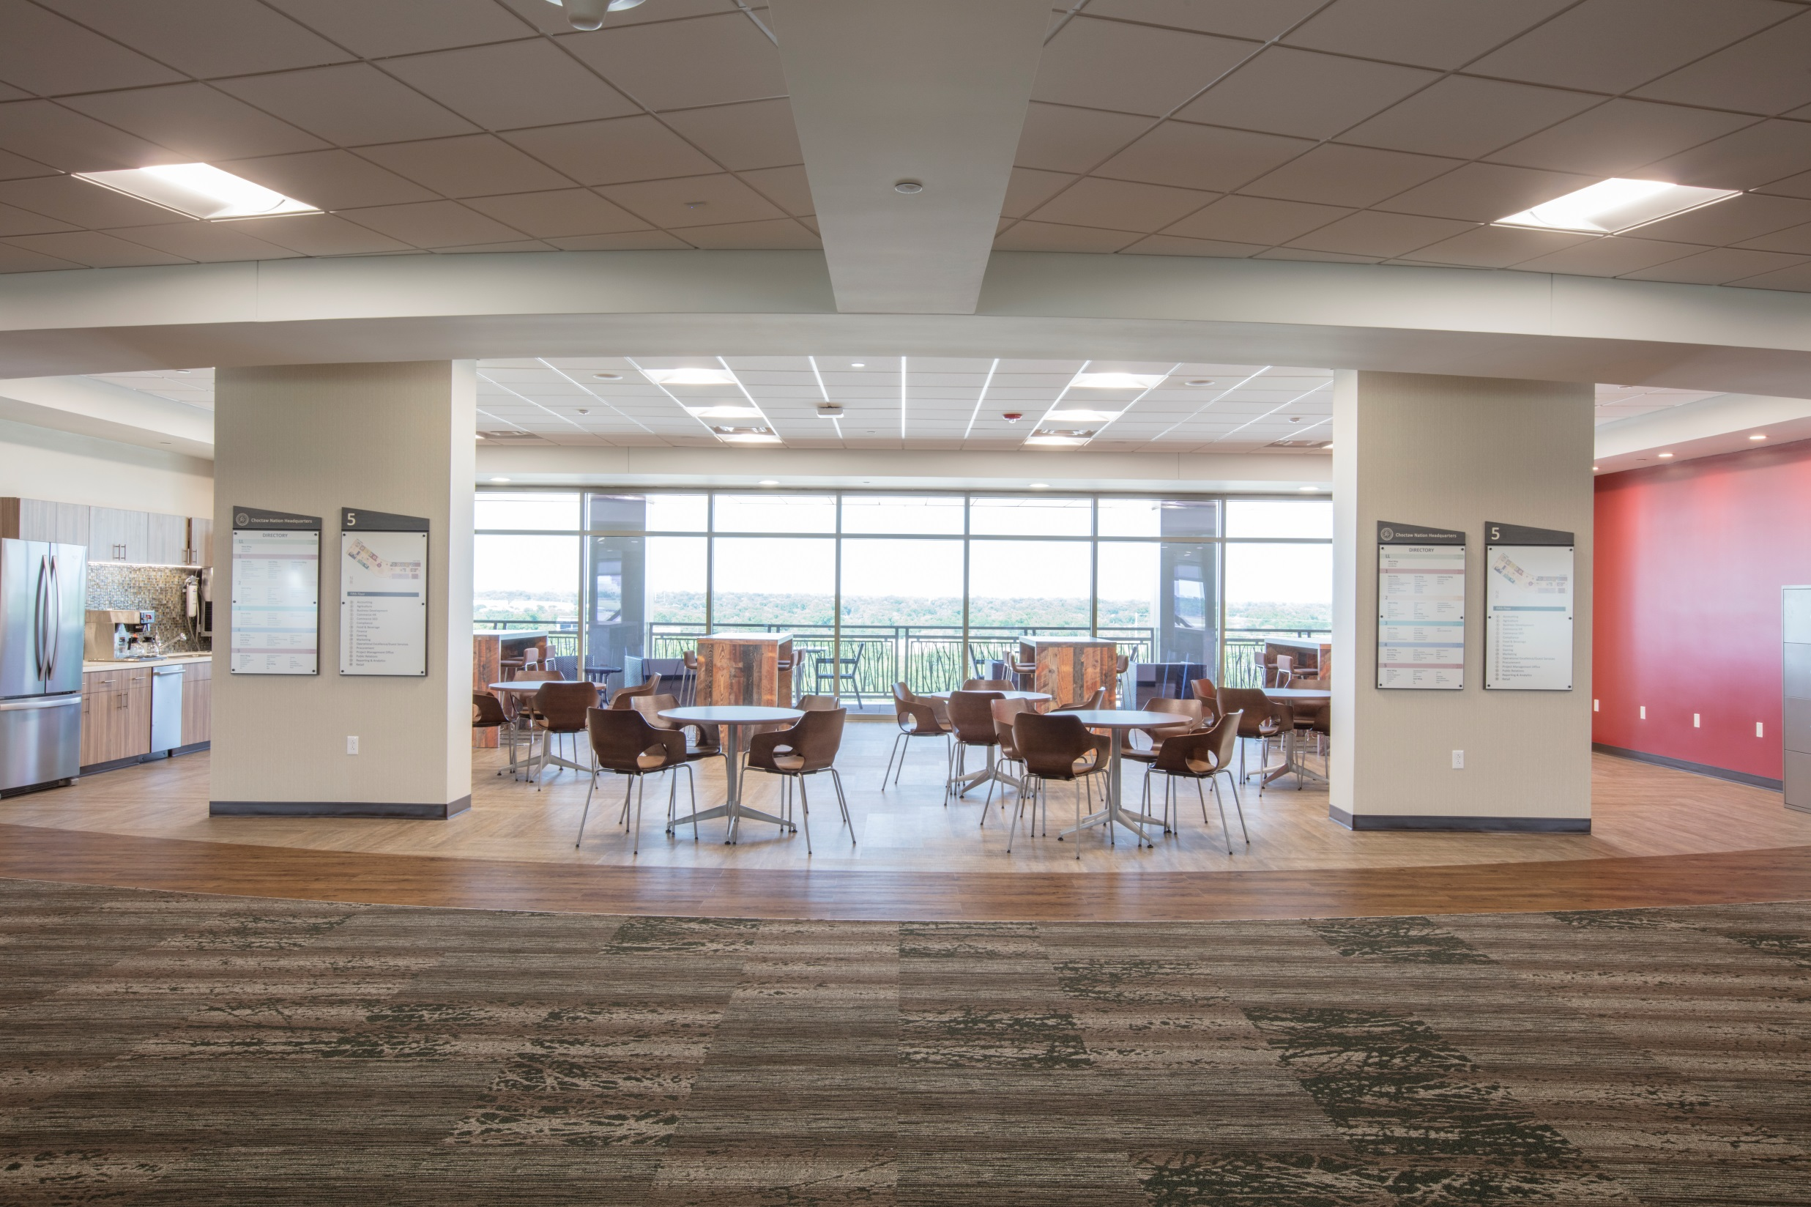
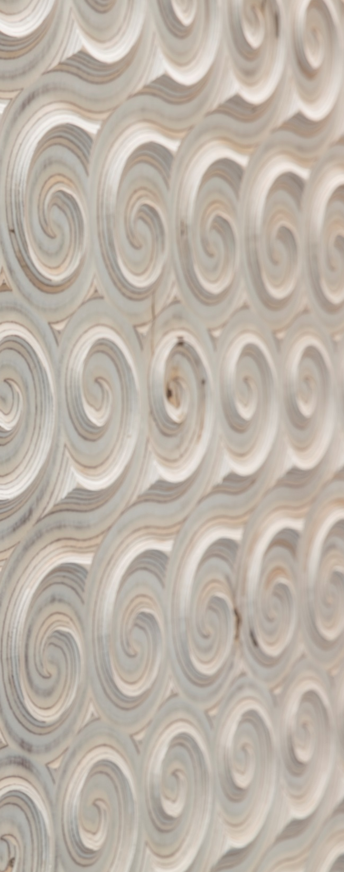
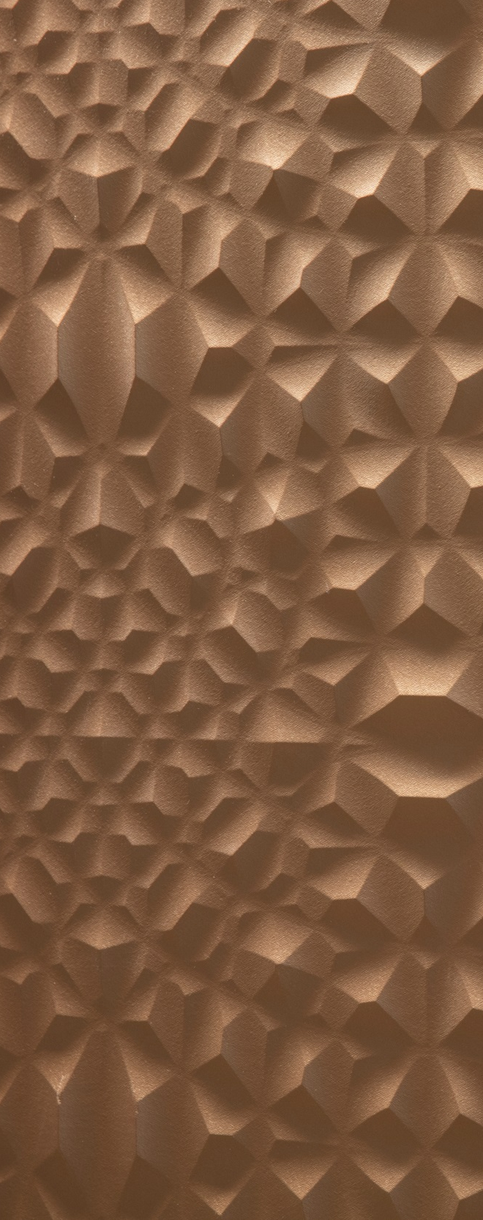
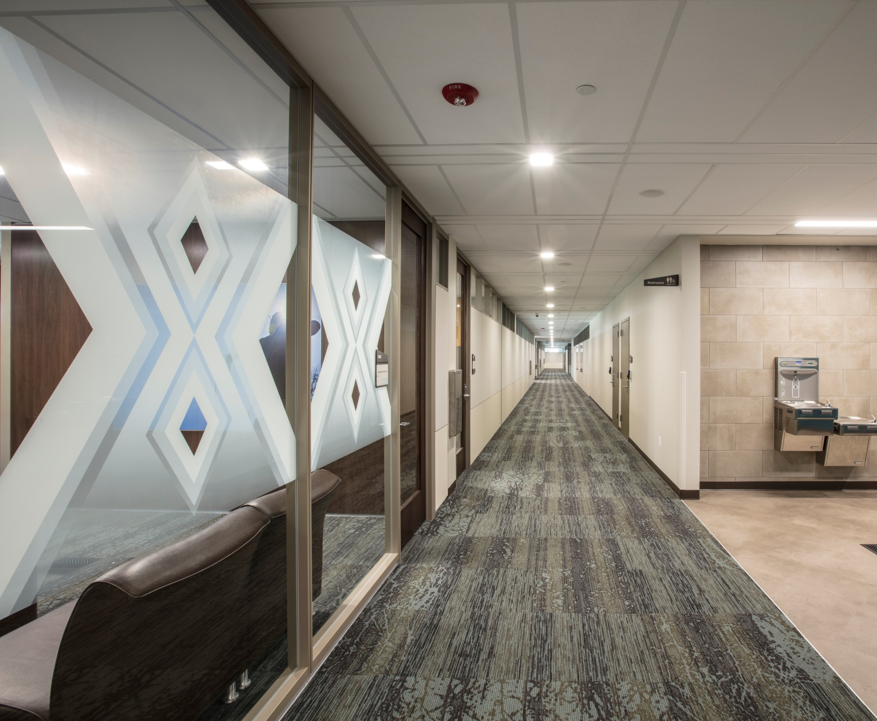
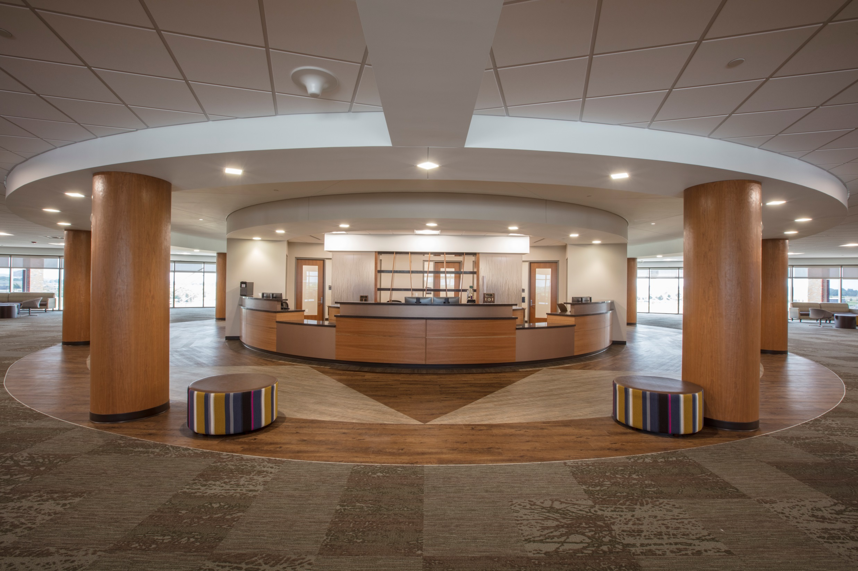
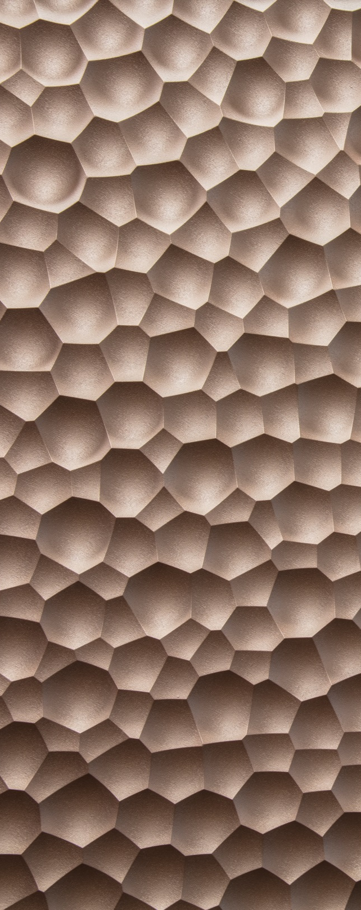
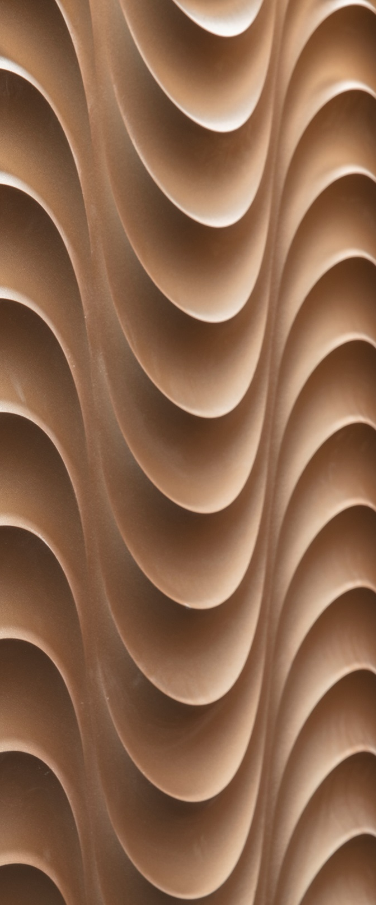
Notes:
Connection with these elements are shown in each of the floors using different materials and textures.

Slide 8
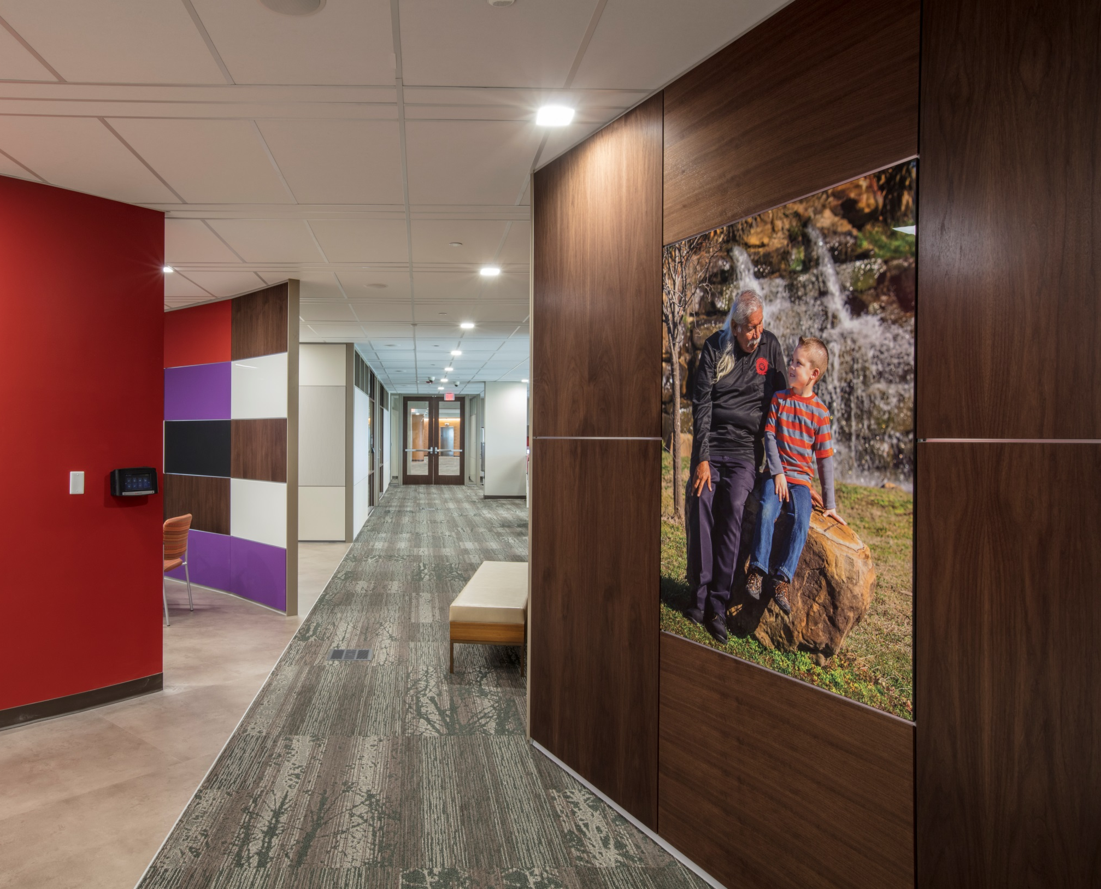
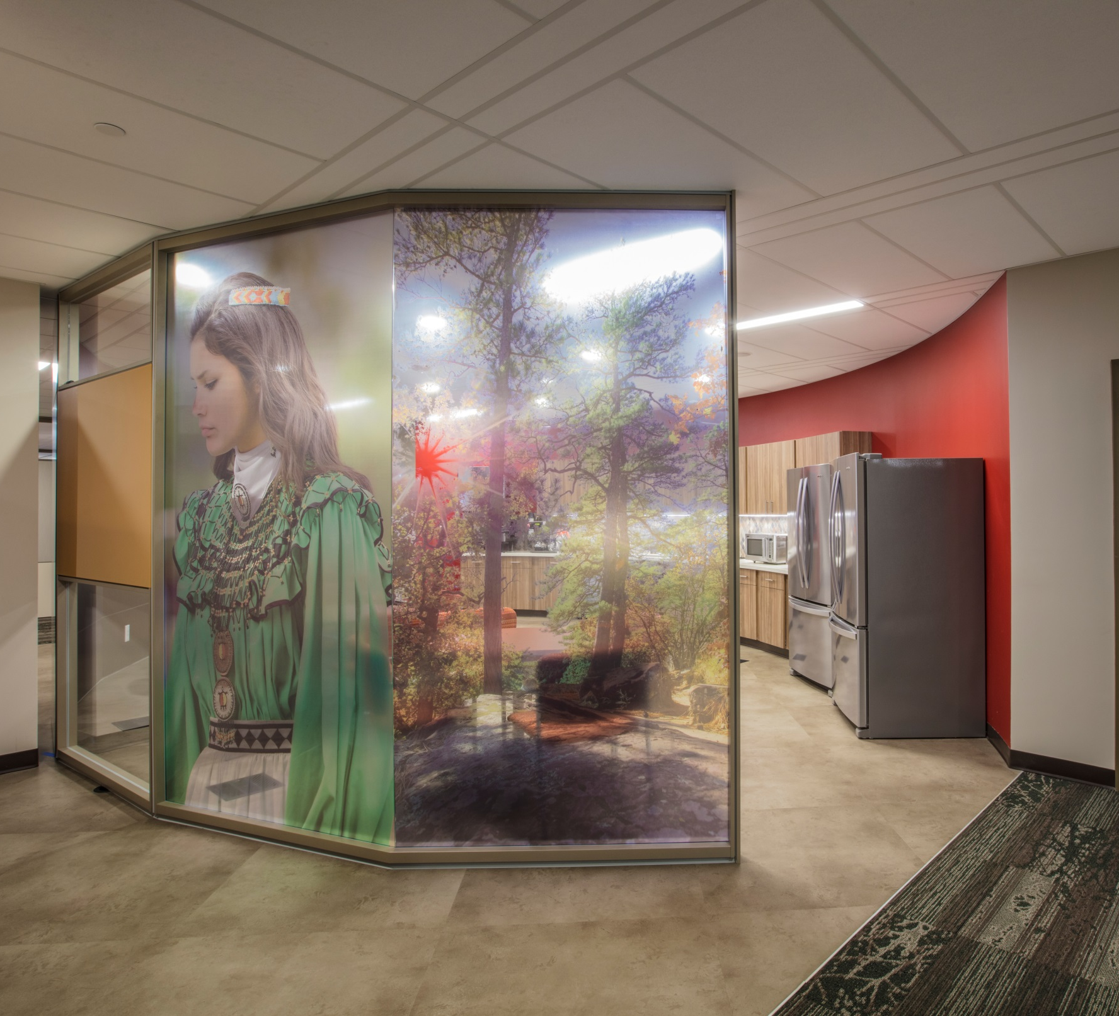
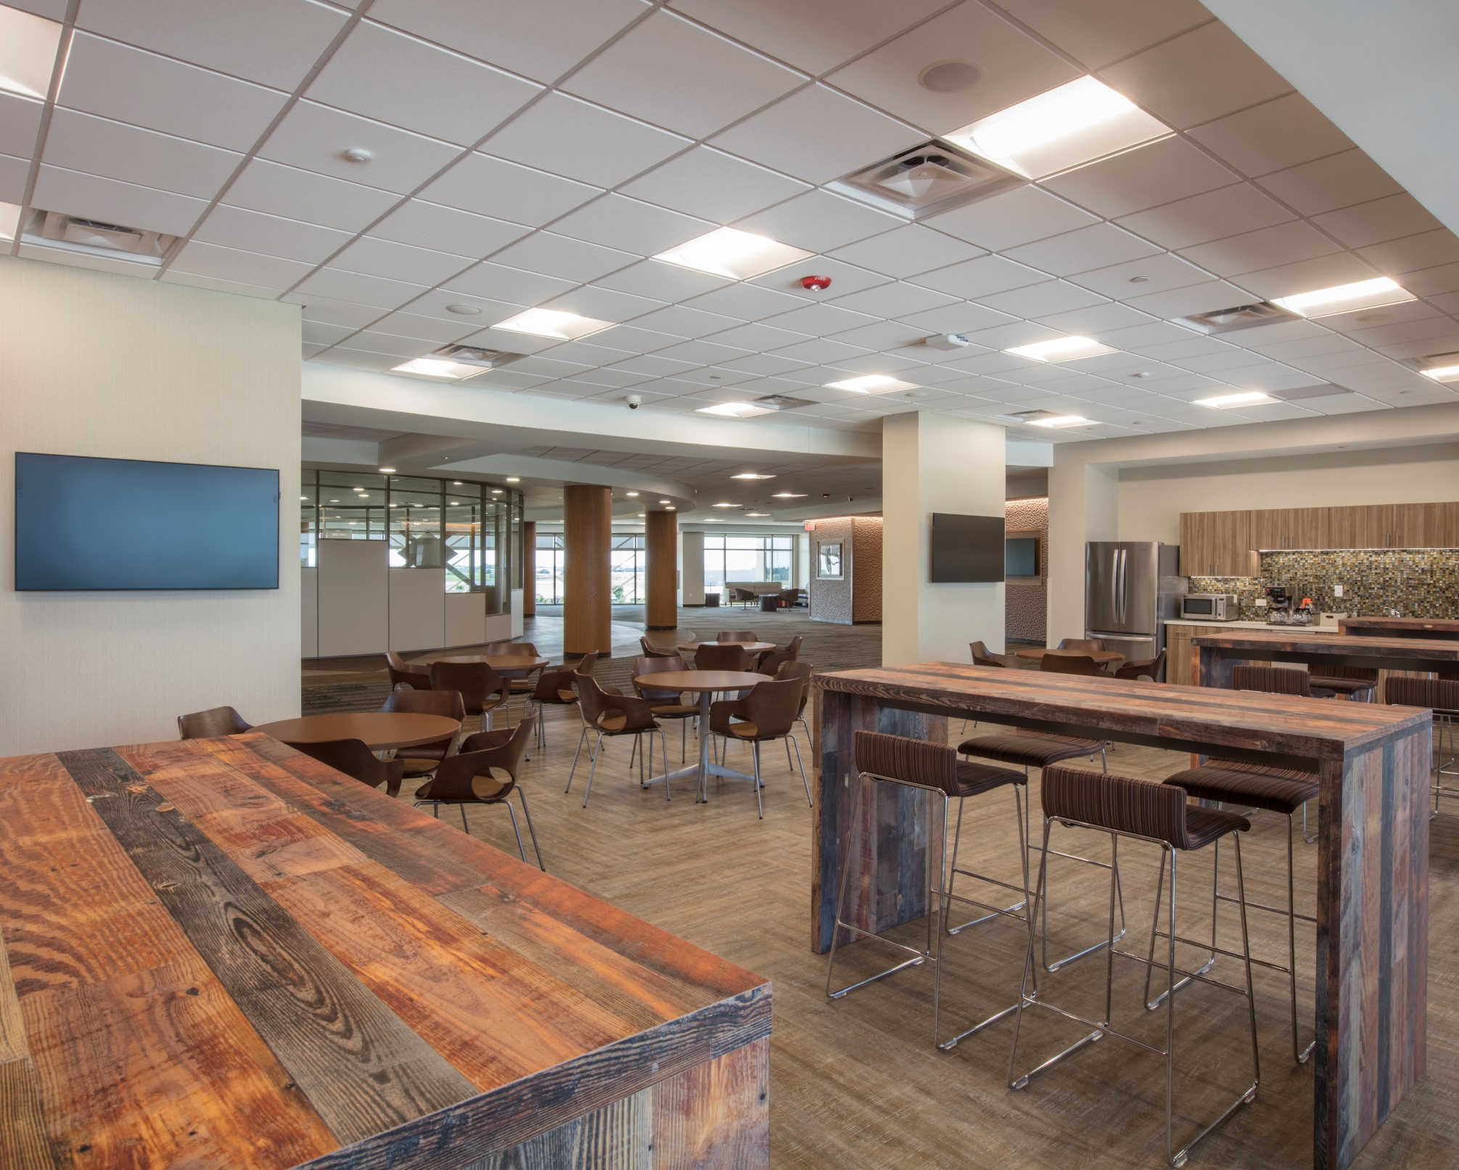
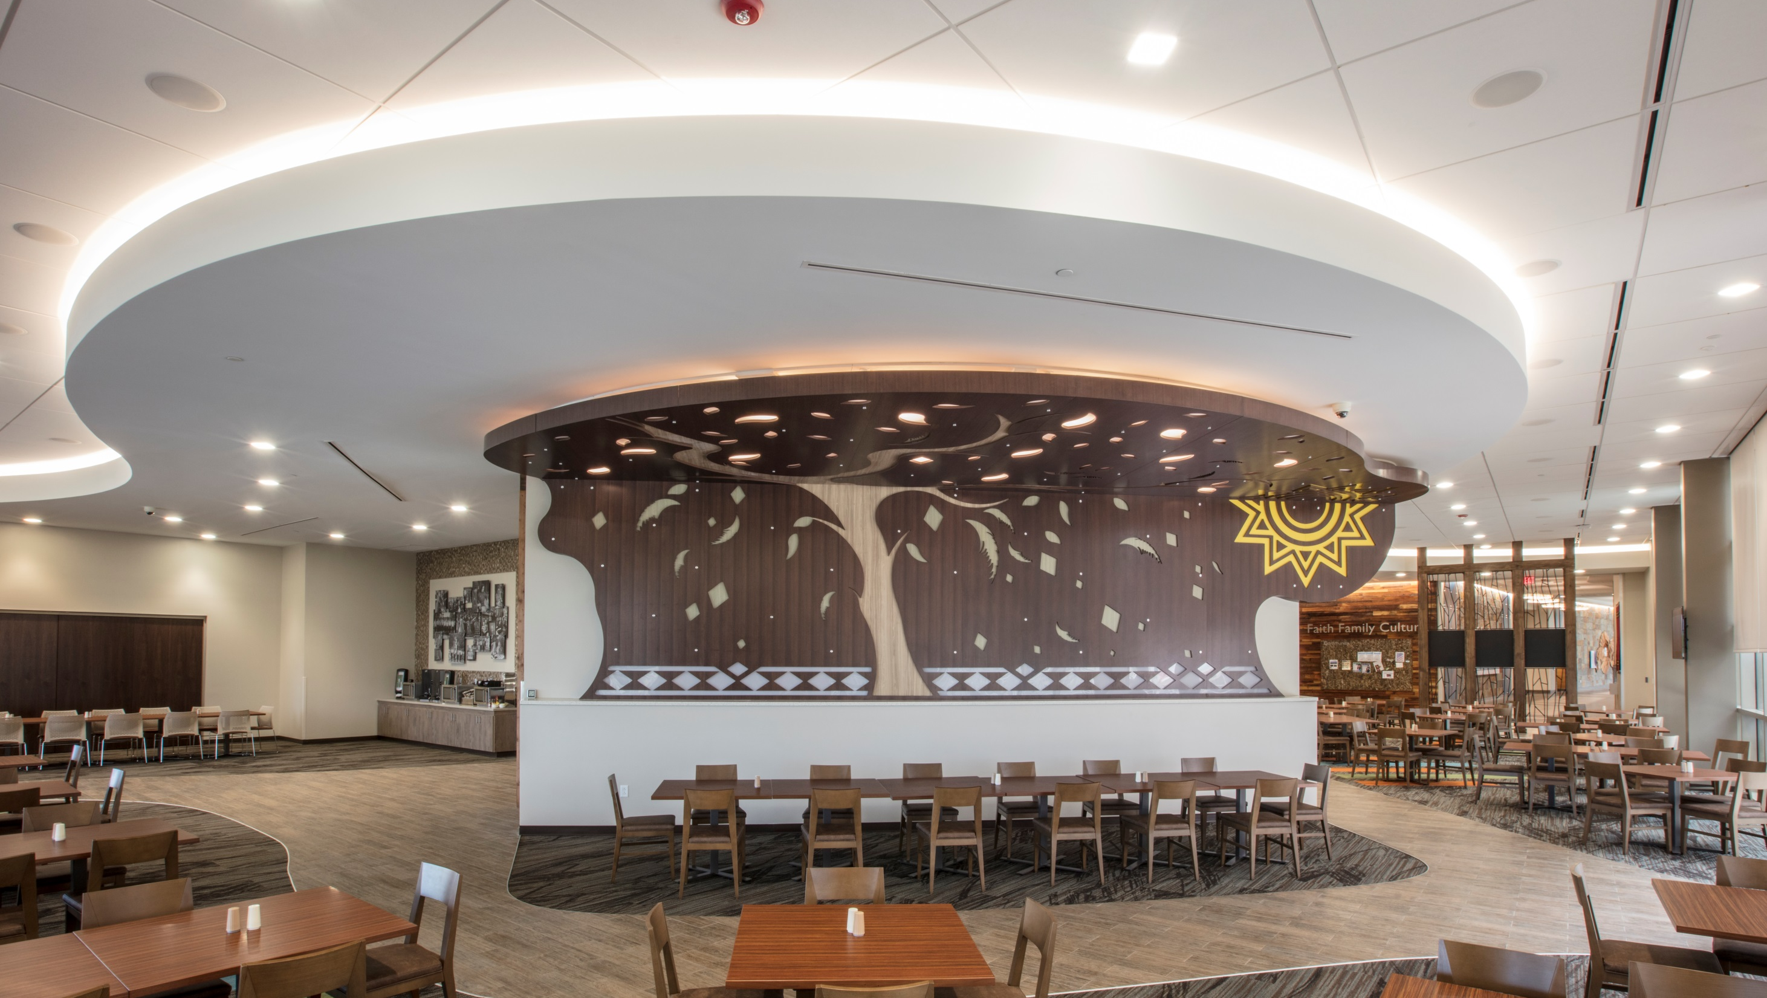
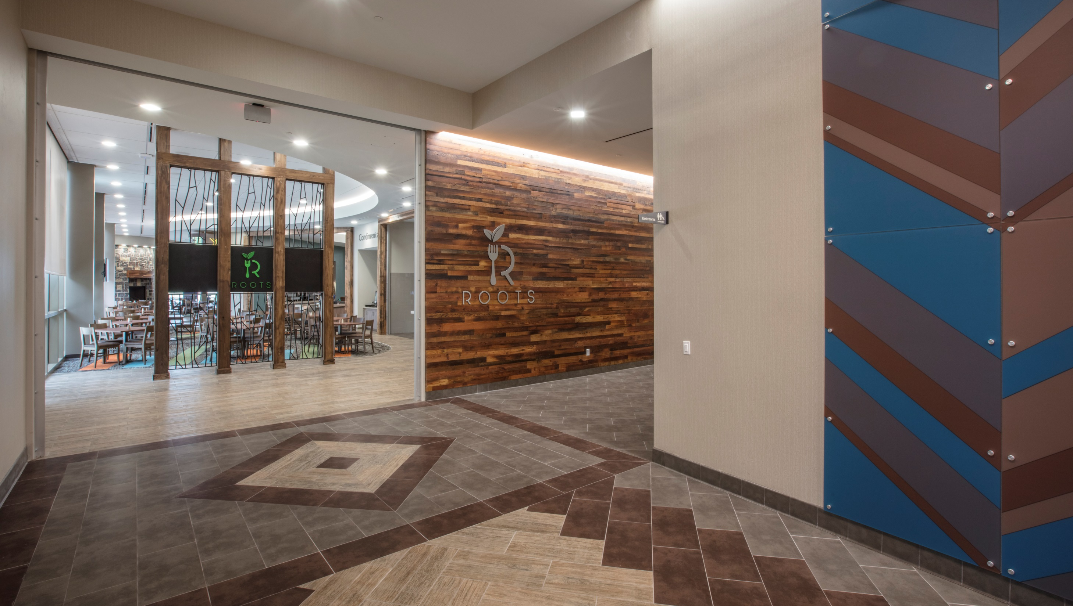
Notes:
Even the restaurant has a lot of associated symbology. Its called Roots, and has the Choctaw Family Tree, which features diamonds, feathers and leaves. Another tribute to family, an art collage of Choctaw people and their families mounted on acrylic, can be found in Roots near the doors leading to the outside patio.

