Slide 1


01. Module One: Have only one God.
Notes:
1st Fire
The Journey Begins - Leaving Our Coastal Home
Responding to the prophecy, the Neshnabek began a mass migration to the west. Guided by the sacred Megis shell of the Midewewin Lodge, the people gathered at a promised turtle-shaped island (Moniyak) near present day Montreal.
The Neshnabek continued their journey, following the Megis to a resting place at Kche Nisajewen (Niagara Falls). It was here that three related but distinct groups formed, the Ojibwe, Odawa and Bodéwadmi. Joined through heritage and spirituality, each group served the Neshnabek as a whole.
the Neshnabel will follow the sacred shell the Megis...to the chosen ground (see homeland You will know..he chosen ground... when you come to a land where food grows on water. If you do not move you will be destroyed
Mshike (Turtle)
The turtle is a revered spint, playing a role in ceremonies and our creation story. Here he symbolizes the beginning and end of our migration

Slide 2

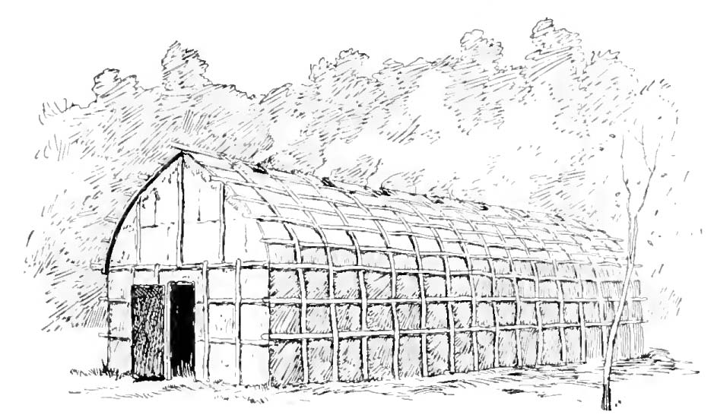
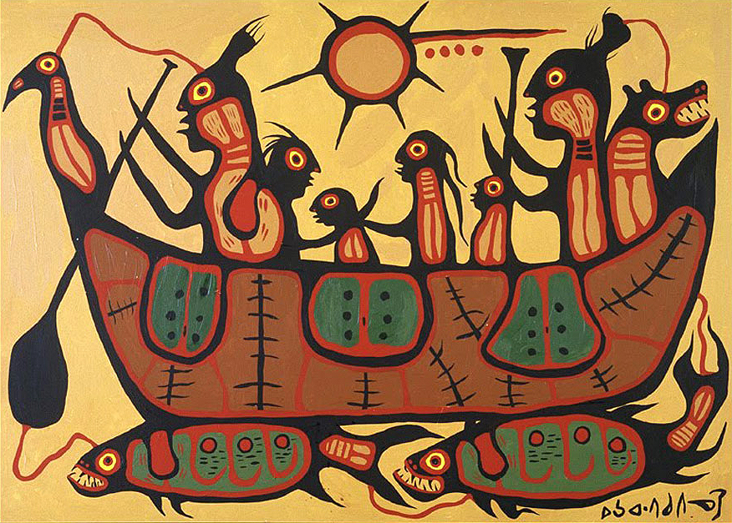
MODULE 01
Notes:
What's the difference between the two pictures you see?
One is flat the other one is more 3D.
Filippo Brunelleschi was an Italian designer and a key figure in architecture during the renaissance period, recognized to be the first modern engineer, planner and sole construction supervisor.
He invented the technique called perspective drawing.
The image that is more 3D was drawn after perspective drawing techniques were invented.
Images
Left: Giorgio Vassari the Madonna and child surrounded around angles, 1280
Right: Raphael the school of Athens, 1509

Slide 3
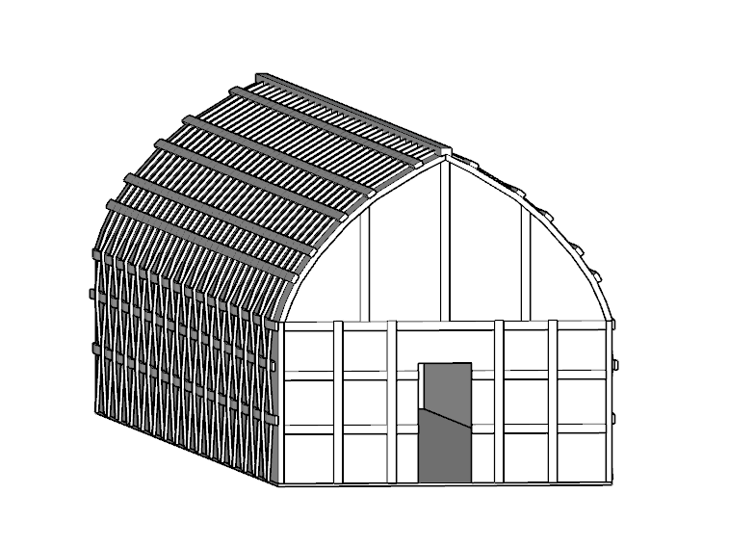
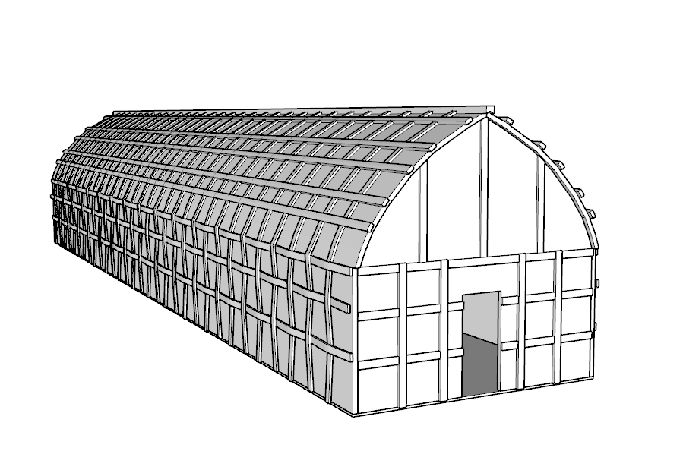
MODULE 01
Isometric View
Perspective View
Notes:
Parallel lines in plans, axons and elevations.

Slide 4
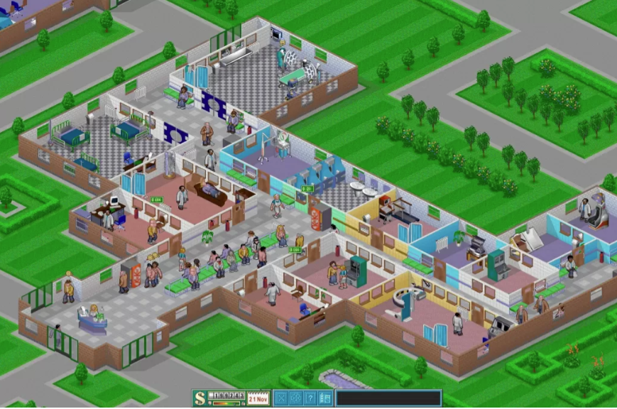
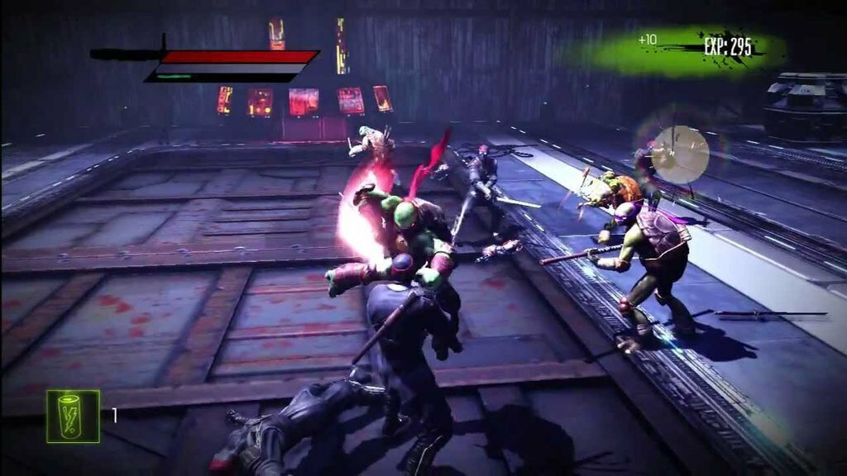
MODULE 01
Parallel /Isometric
Perspective

Slide 5
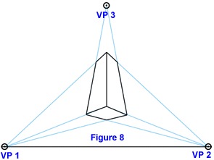
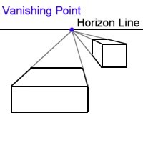
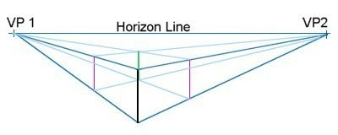
MODULE 01
Perspectives
One point
Two point
Three point
Two point
One Point Perspective
Two Point Perspective
Three Point Perspective
Notes:
Explain the differences in perspective types
Show examples

Slide 6
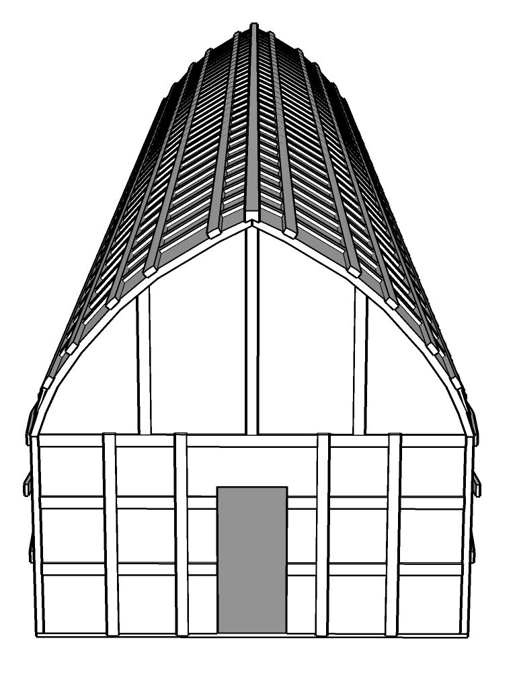
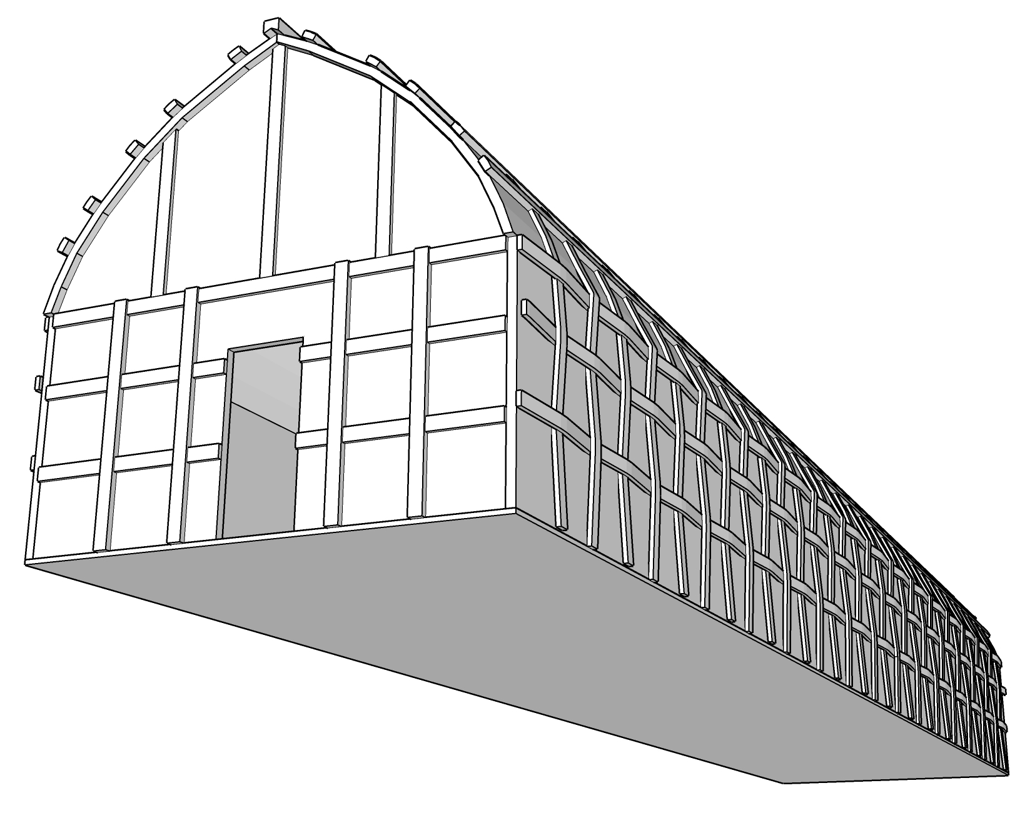
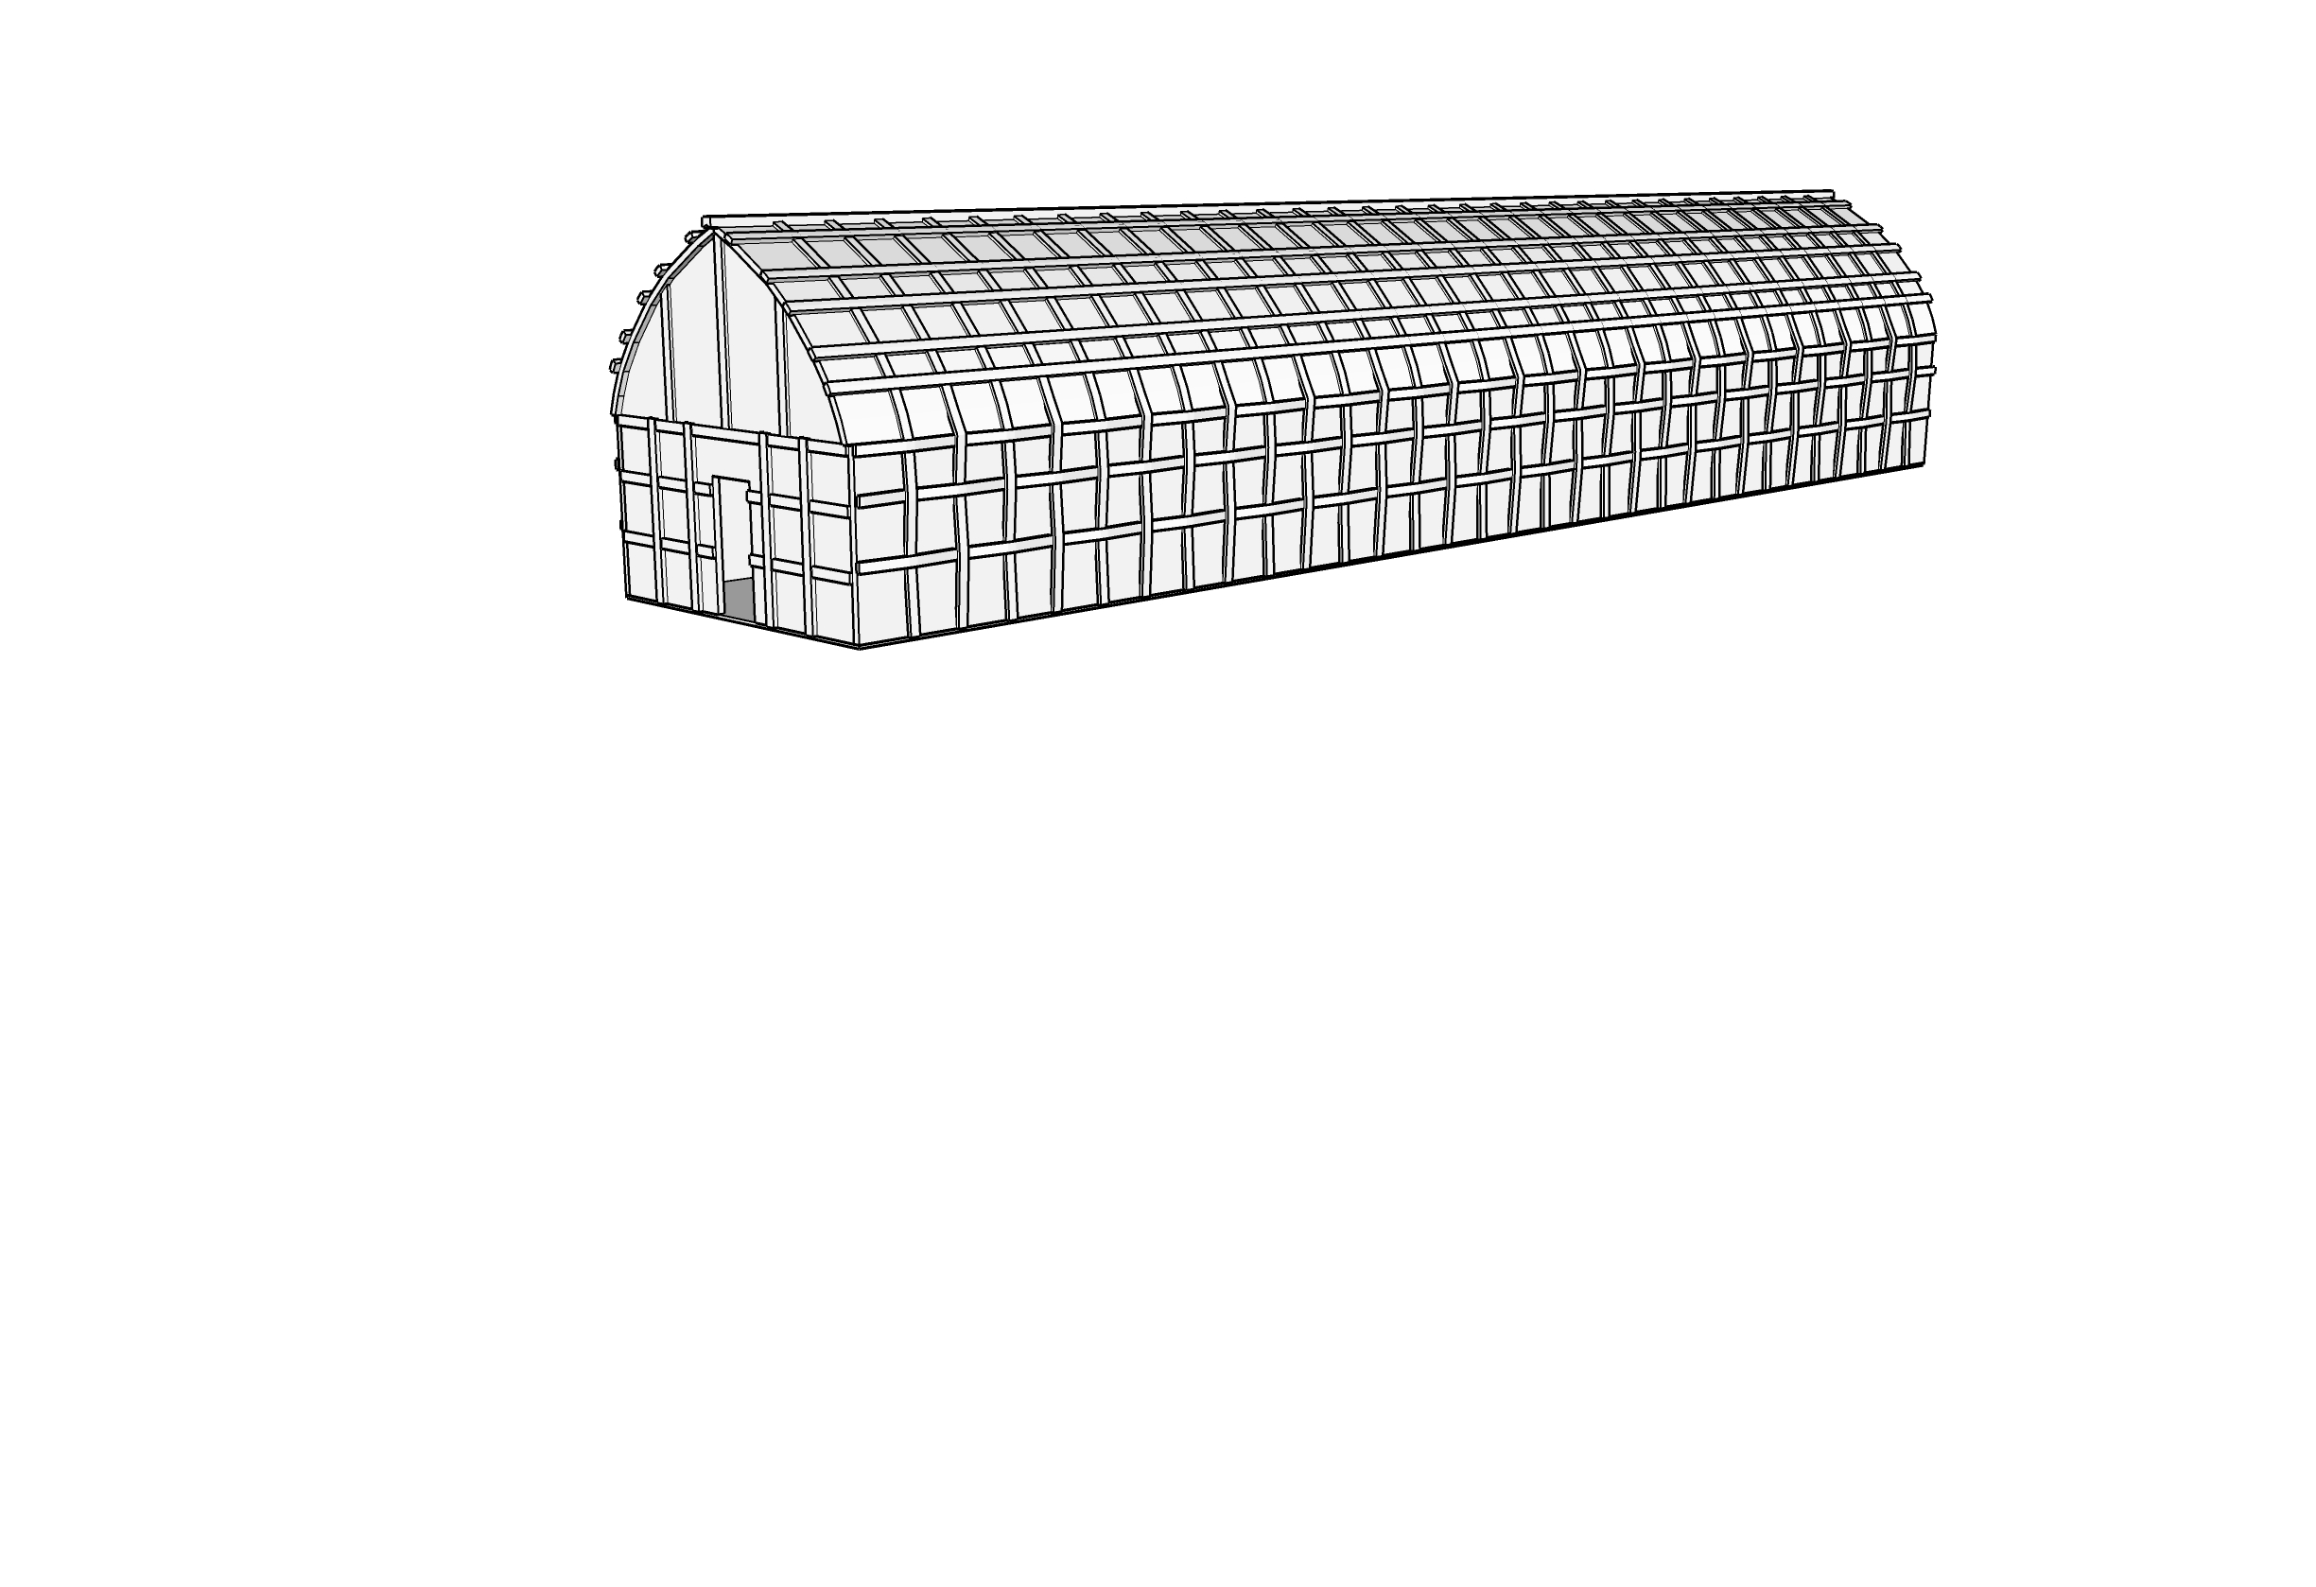
Perspectives
Three point
Two point
One point
MODULE 01
3
1
2
One Point Perspective
Two Point Perspective
Three Point Perspective
Notes:
There are 3 main perspective projection types.
Three point, two point and one point.
These lines are not parallel to each other.
The difference is that the lines vanish at 3 points, 2 points and 1 point respectively (show how the lines vanish)

Slide 7
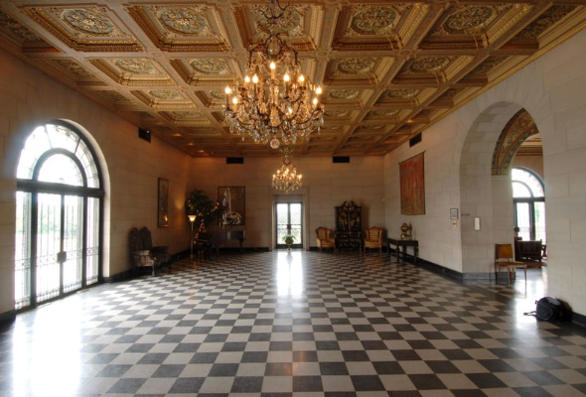
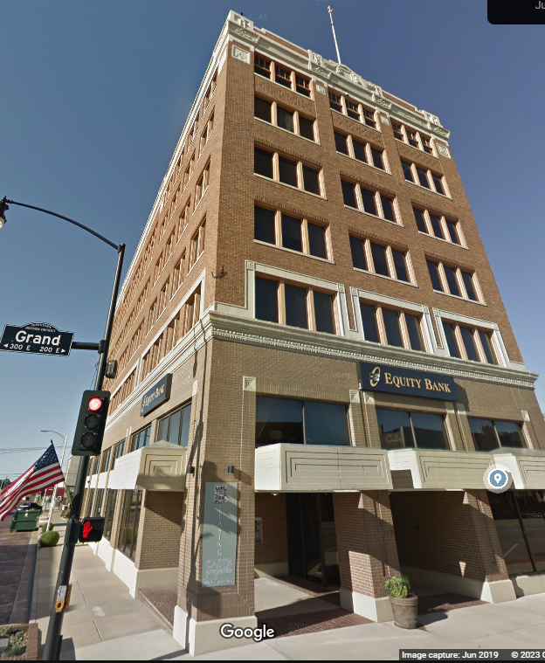
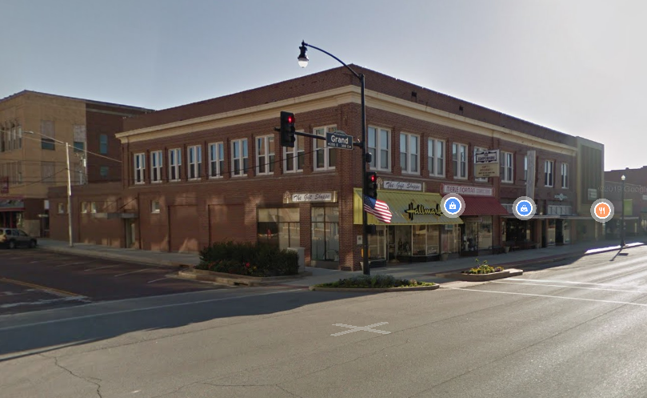
MODULE 01
MODULE 01
Notes:
Examples of different perspectives
Show how the lines converge at different vanishing points in the next slide

Slide 8
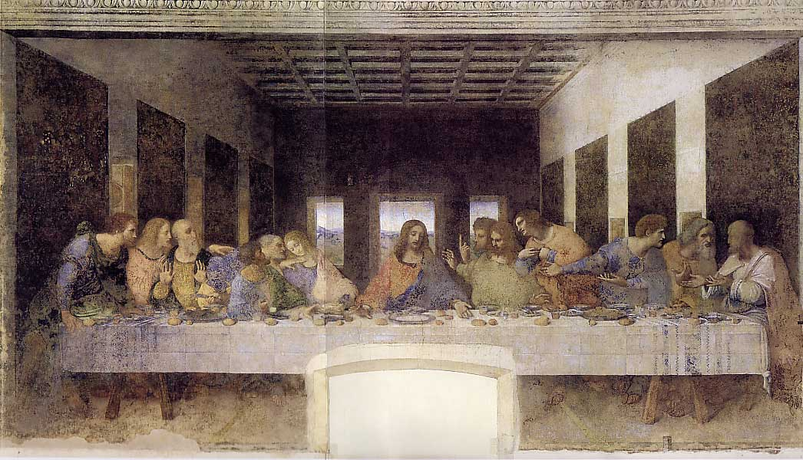
The Last Supper
Leonardo da Vinci
MODULE 01
MODULE 01
Two Point Perspective
One-Point Perspective
Notes:
Ask what kind of a perspective this is

Slide 9
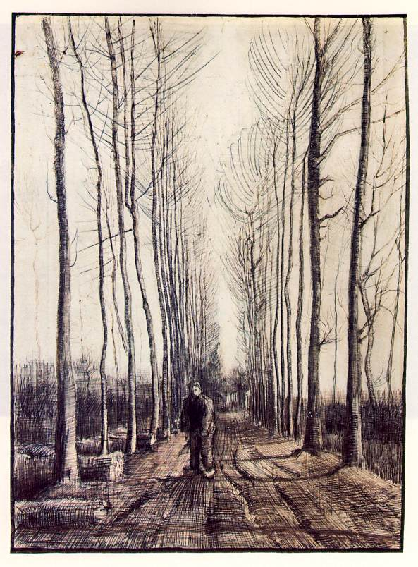
Lane With Poplar Trees
Vincent Van Gogh
MODULE 01
MODULE 01
One-Point
Perspective
Notes:
Ask what kind of a perspective this is

Slide 10
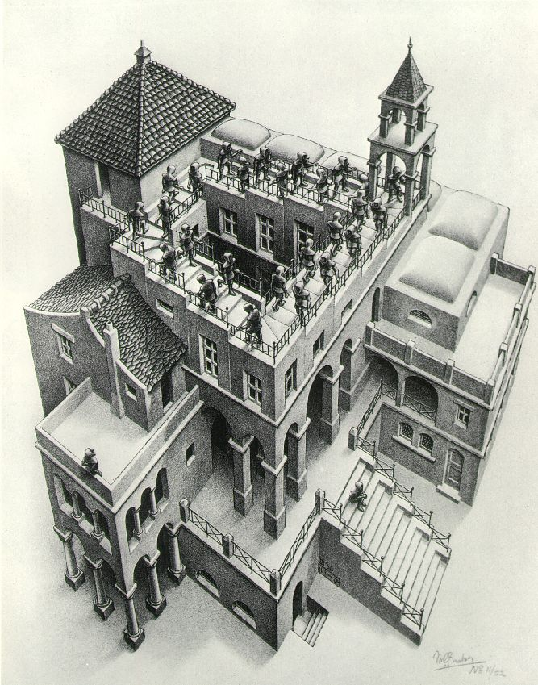
Ascending and Descending
M.C. Escher
MODULE 01
MODULE 01
Three-Point
Perspective
Notes:
Ask what kind of a perspective this is

Slide 11
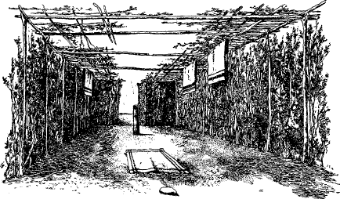
MODULE 01
MODULE 01
One Point Perspective
Notes:
Example of 1 point perspective

Slide 12
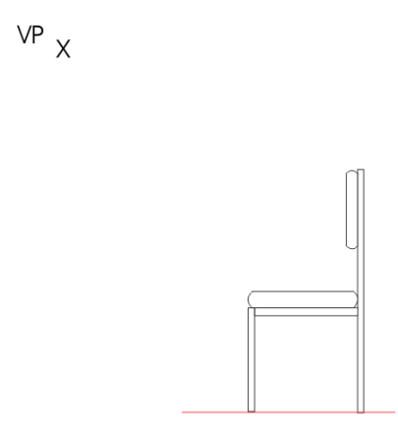
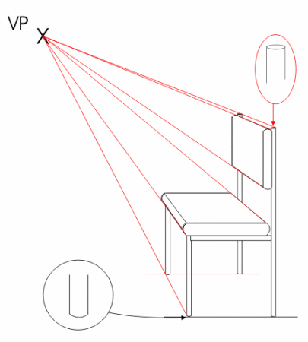
MODULE 01
MODULE 01
One point Perspective Drawings
2D
3D
Notes:
How to draw one point perspectives
Just join the corners of a 2d drawing to a single point
You get a 3D object

Slide 13
MODULE 01
MODULE 01
Vanishing point
Horizon line
Orthogonal lines
Notes:
Example of 1 point perspective

Slide 14
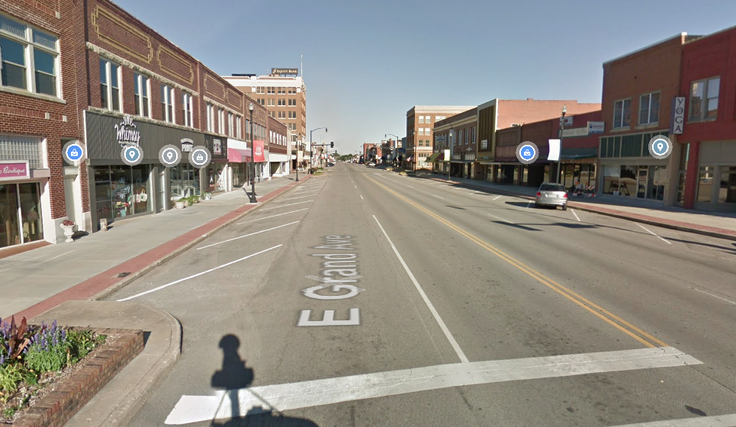
MODULE 01
MODULE 01
Notes:
Name the elements of a one point perspective

Slide 15
MODULE 01
MODULE 01
One point Perspective Drawings
Draw a horizon line
Notes:
How to draw a one point perspective step by step
Ask the audience to follow by using a piece of paper and drawing

Slide 16
MODULE 01
MODULE 01
One point Perspective Drawings
Make a vanishing point
Notes:
How to draw a one point perspective step by step
Ask the audience to follow by using a piece of paper and drawing

Slide 17
MODULE 01
MODULE 01
One point Perspective Drawings
Draw a square or rectangle
Notes:
How to draw a one point perspective step by step
Ask the audience to follow by using a piece of paper and drawing

Slide 18
MODULE 01
MODULE 01
One point Perspective Drawings
Draw orthogonals from shape corners to vanishing point
Notes:
How to draw a one point perspective step by step
Ask the audience to follow by using a piece of paper and drawing

Slide 19
MODULE 01
MODULE 01
One point Perspective Drawings
Draw horizontal line to end your shape
Notes:
How to draw a one point perspective step by step
Ask the audience to follow by using a piece of paper and drawing

Slide 20
MODULE 01
MODULE 01
One point Perspective Drawings
Draw a vertical line to make the form’s side
Notes:
How to draw a one point perspective step by step
Ask the audience to follow by using a piece of paper and drawing

Slide 21
MODULE 01
MODULE 01
One point Perspective Drawings
Erase the orthogonals
Notes:
How to draw a one point perspective step by step
Ask the audience to follow by using a piece of paper and drawing

Slide 22
MODULE 01
MODULE 01
Vanishing Point
Notes:
Depending on where the horizon line is, in effect where the vanishing point is you can see the difference in the one point perspectives in the example.

Slide 23
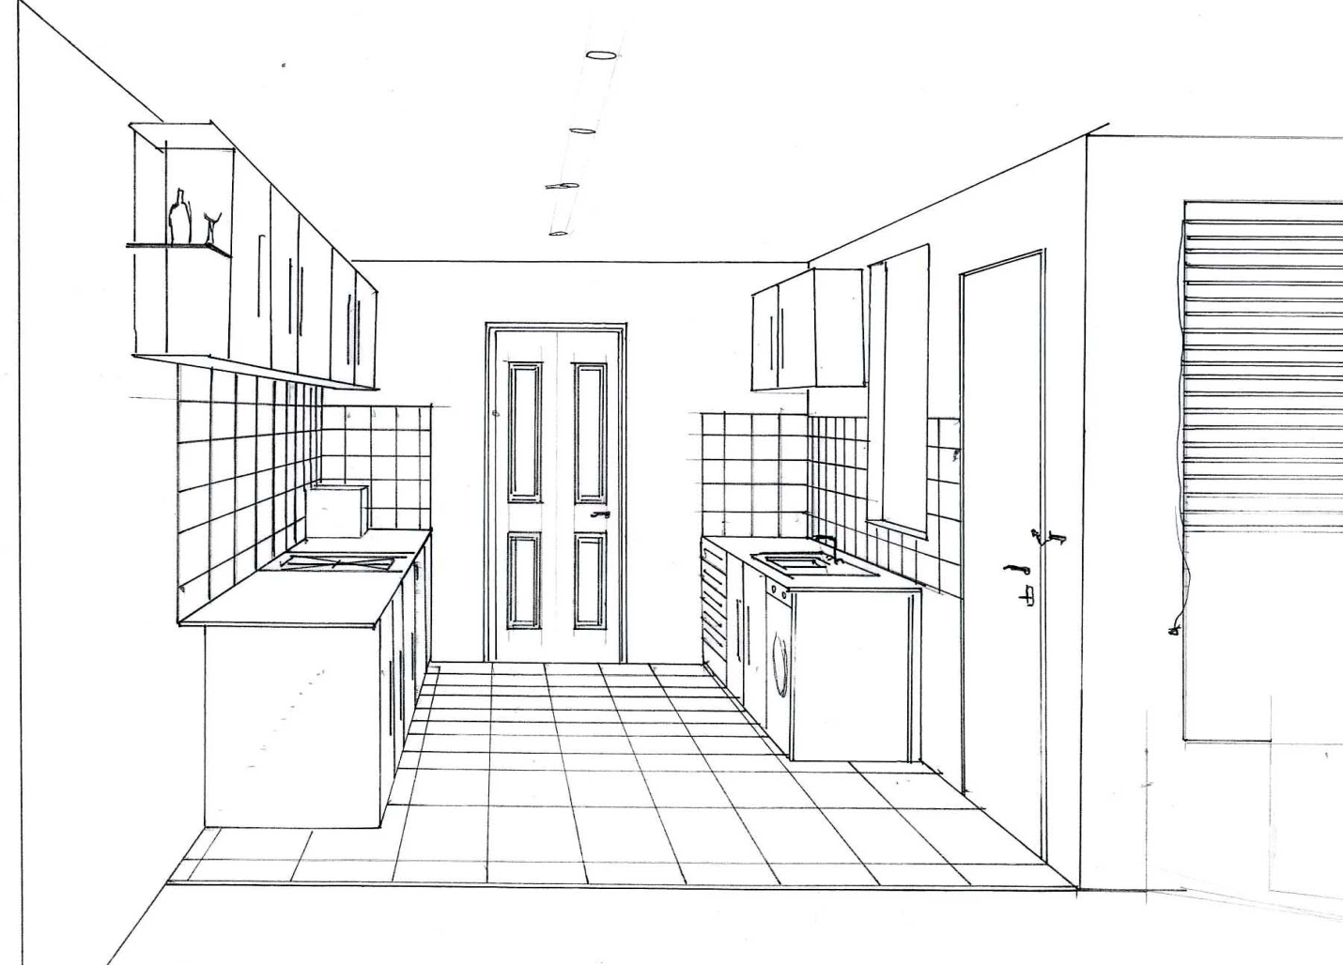
MODULE 01
MODULE 01
Notes:
How lines converge to construct a one point perspective of a indoor space.
Show the lines vanishing at the door.

Slide 24
MODULE 01
MODULE 01
Two Point Perspective

Slide 25
MODULE 01
MODULE 01
Vanishing point
Vanishing point
Orthogonal lines
Horizon line
Notes:
Example of 1 point perspective

Slide 26
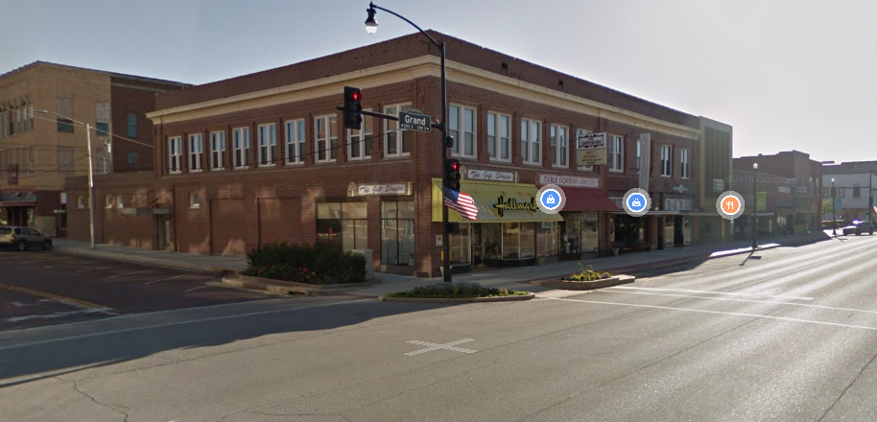
MODULE 01
MODULE 01
Orthogonal lines
Vanishing point
Vanishing point

Slide 27
MODULE 01
MODULE 01
Step 1
Notes:
Steps in constructing a 2 point.
Ask the audience to follow by using a piece of paper and drawing.

Slide 28
MODULE 01
MODULE 01
Step 2
Notes:
Steps in constructing a 2 point.
Ask the audience to follow by using a piece of paper and drawing.

Slide 29
MODULE 01
MODULE 01
Step 3
Notes:
Steps in constructing a 2 point.
Ask the audience to follow by using a piece of paper and drawing.

Slide 30
MODULE 01
MODULE 01
Step 4
Notes:
Steps in constructing a 2 point.
Ask the audience to follow by using a piece of paper and drawing.

Slide 31
MODULE 01
MODULE 01
Step 5
Notes:
Steps in constructing a 2 point.
Ask the audience to follow by using a piece of paper and drawing.

Slide 32
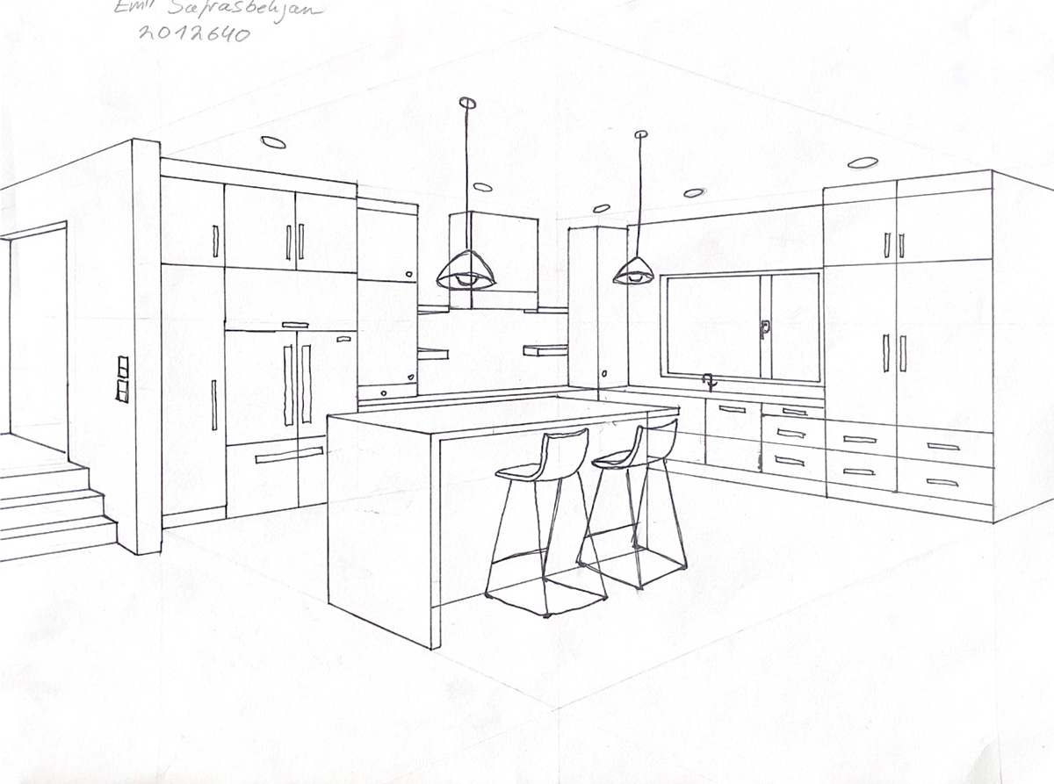
MODULE 01
MODULE 01

